Slide 1
Dr Elizabeth Gadd
Research Policy Manager (Publications)
@lizziegadd
The changing world of research evaluation

Slide 2
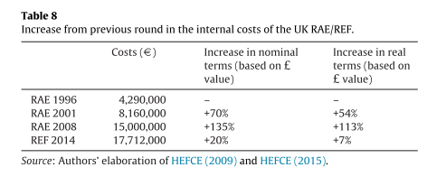
More evaluation
International evaluation
Increase in rankings (global, national, subject)
Mainly based on research indicators
Citations play most significant role
National research evaluation exercises
Increase in number and sophistication
Link with funding
University self-evaluation
Academic self-evaluation
(“measure for pleasure”)

Slide 3
More competition
Rankings regularly increase the number of HEIs ranked
More focus on excellence world domination
More grant applications, less funding
More PhDs, fewer academic posts
Prof Chris Jackson, Imperial College London:

Slide 4
More at stake
For HEIs:
Funding & reputation linked with
university ranking position
national research evaluation exercises
Declining student fee environment (UK), increased pressure on research income.
For academics:
Recruitment & promotion based on publication performance
For journals:
Race to the upper echelons of the JIF

Slide 6
Use of AI to boost JIFs

Slide 7
More pressure on the academy

Slide 8
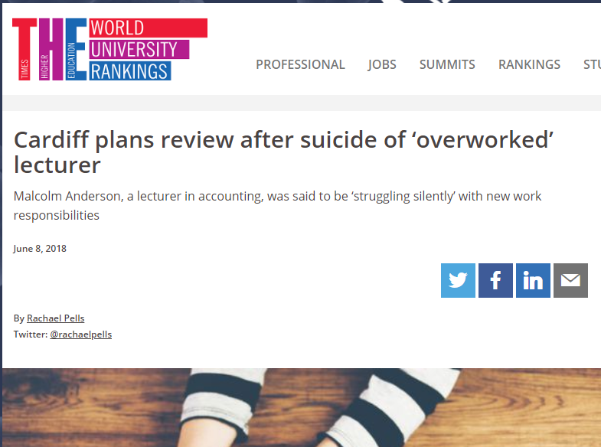
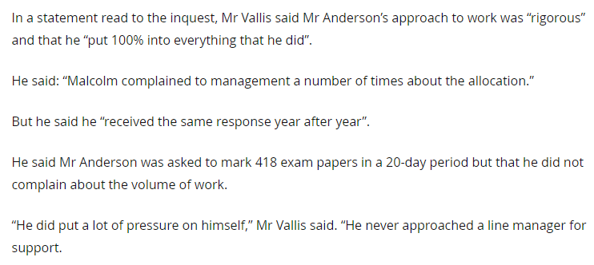

Slide 10
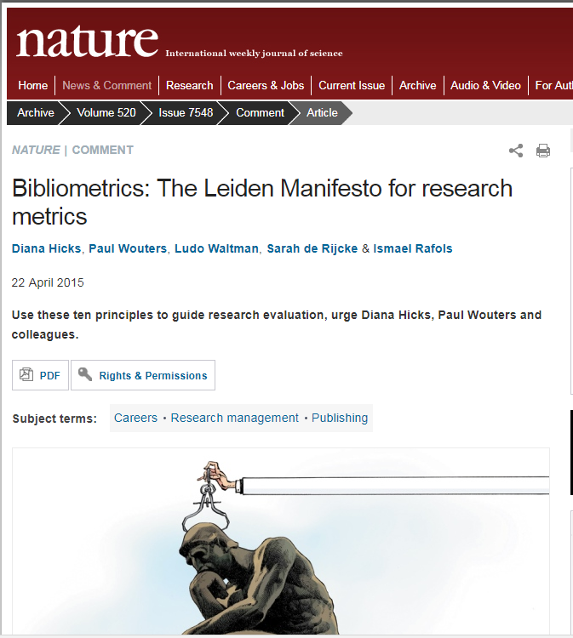
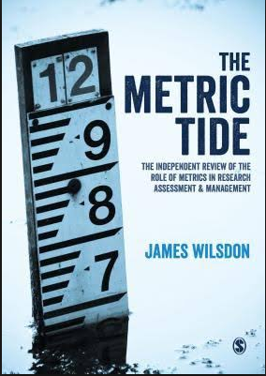
More need for responsible metrics

Slide 11
Response to DORA

Slide 12
Statements on responsible metrics

Slide 13
UK HEI 2017 survey on responsible metrics

Slide 15
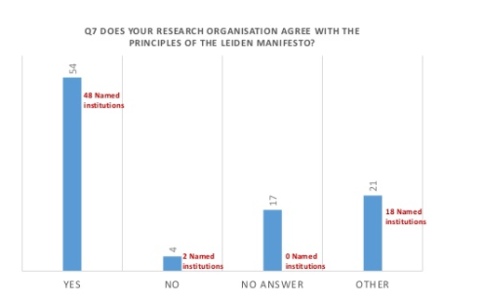

Slide 16
International response to DORA

Slide 17
Example: Loughborough’s responsible metrics policy
Focussed on bibliometrics
Ratified by Senate in November 2016
Essentially a local implementation of the Leiden Principles
Main local implementation is that Schools choose their own metrics
Generated a list of ‘sensible’ indicators for individual/group/school analysis

Slide 18
Loughborough’s policy

Slide 19
And not just from universities…
Research assessment bodies
Research funders
University ranking organisations
Data vendors

Slide 21
REF results

Slide 22
Who is responsible for responsible metrics?
Research assessment bodies
Research funders
University ranking organisations
Data vendors

Slide 23
Gunashekar, S., Wooding, S. & Guthrie, S., 2017. How do NIHR peer review panels use bibliometric information to support their decisions? Scientometrics, 112(3), pp.1813–1835.

Slide 24
Who is responsible for responsible metrics?
Research assessment bodies
Research funders
University ranking organisations
Data vendors

Slide 25
Who is responsible for responsible metrics?
Research assessment bodies
Research funders
University ranking organisations
Data vendors

Slide 26
More types of metrics
From: European Commission, 2017. Next-generation metrics: Responsible metrics and evaluation for open science,

Slide 27
More data sources

Slide 28
Three new tools THIS YEAR
Dimensions
1Finder
Wizdom.ai

Slide 29
More indicators - individuals
Notes:
.

Slide 30
More indicators - journals
Journal Impact Factor (JIF)
Current Impact Factor (CIF)
Immediacy Index (II)
Annual Impact Factor (AIF)
Annual Impact Rate (AIR)
Journal Citation Score (JCS)
Cited Half Life Impact Factor (CHAL)
Median Impact Factor (MIF)
Weighted Impact Factor (WIF)
Diachronous Impact Factors
Journal Diffusion Factors
Diachronous Journal Diffusion Factors
Synchronous Journal Diffusion Factors
Relative Journal Diffusion Factors
Field Impact Factor (FIF)
Renormalised Impact Factor
Current Contribution Index (CCI)
Specific Impact Contribution (SIC)
Relative Journal Citation Rate (RJCR)
Relative Measurement Index (RM-Index)
Disciplinary Impact Factor (DIF)
Global Impact Factor (GIF)
Relative Impact Factor (RIF)
Adjusted Impact Factor (AIF)
Adjusted Immediacy Index (AII)
Average Indifference Factor (ADF)
Global Indifference Factor (GDF)
Knowledge Export Ratio (KIR)
International Journal Impact Factor (IJIF)
External Journal Impact Factor (EJIF)
Journal Integrated Impact Indicator (JIII)
Aggregated Citations of Cited Articles (ACCA)
Audience Factor (AF)
Source Normalised Impact Factor (SNIP)
Modified SNIP
Raw Impact per Paper (RIP)
Relative Database Citation Potential (RDCP)
Database Citation Potential (DCP)
Popularity Factor (PF)
Journal h-index
Journal Self-Citation Ratio (SCR)
Journal Self Link (SLI)
Reference Ratio (RR)
Download Immediacy Index (DII)
Gatekeeper Index (GI)
Impact Factor Point Average (IFPA)
Eigenfactor
Scimago Journal Rank
CiteScore
Article Influence Score
And so on……………………..

Slide 31
Notes:
.

Slide 32
More complicated

Slide 33
More costly
Growth in subscriptions to citation benchmarking tools
Growth in number of research impact/ bibliometrician posts
Increase in seniority of those posts

Slide 34
Bakker & McBurney (2017) https://conservancy.umn.edu/handle/11299/188632
Notes:
”

Slide 35
Bakker & McBurney (2017) https://conservancy.umn.edu/handle/11299/188632

Slide 36
HEI research evaluation costs UK & US
1 citation tool
1 research metrics post
£90,000 p.a.
1 “FAR” tool
1 Research Impact Librarian
$175,000 pa

Slide 37
More sophisticated analyses
More mashups
More demand for open data
& increased download limits
…with standard identifiers
More use of data visualisation tools
Tableau
PowerBI
…and network analysis tools
VosViewer
…and use of statistical techniques to calculate confidence intervals on supplier data

Slide 38
…require more skills

Slide 39
A lack of formal training
29%
The proportion of Librarians surveyed whose
LIS degree included bibliometrics

Slide 40
Lack of statistical knowledge
Notes:
.

Slide 41
Bibliometric competencies

Slide 42
Competency levels of practitioners

Slide 43
The Bibliomagician https://thebibliomagician.wordpress.com/

Slide 44
Statistics for Responsible Bibliometrics workshop
https://thebibliomagician.wordpress.com/2018/06/28/course-summary-statistics-for-responsible-bibliometrics/

Slide 45
More systemic effects
What are the large-scale systemic effects of research evaluation in its current form?
Streetlight effect
A focus on the data we have not what we value
Outsourced values
A focus on what others value (rankers, funders, governments) not what we value
What do we value?

Slide 48
Campbell’s law
#MeasureWhatMatters

Slide 49
More calls to measure openness
European Recommendation on Access to Scientific Information
Member States should ensure that…through the use of additional indicators and metrics, infrastructures are fit to collect information that underpins the monitoring and assessment of openness and open science as well as of research and career evaluation.

Slide 50
Summary
More evaluation activity leads to…
More need to evaluate responsibly
More data sources & indicators leads to…
More need for competent evaluators
Evaluating responsibly needs to start by understanding what (& who) we value

Slide 51
Thank you for listening
Dr Elizabeth Gadd
Research Policy Manager (Publications)
Loughborough University
Skype: lizziegadd
Twitter: @lizziegadd
Email: e.a.gadd@lboro.ac.uk
http://orcid.org/0000-0003-4509-7785
http://about.me/elizabeth.gadd

