Slide 1
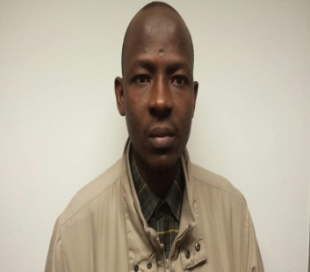
Characterization of Two-Phase Flow in Porous Media and Applications to the Monitoring
of Geological Carbon Sequestration
Project duration: 3 years
Supervisor: Dr. Diganta Das, Prof. C.D. Rielly
Main research question: What are the implications of non-uniqueness in the characterization parameters of two-phase flow systems in the porous media?
Relevance for implementation of CCS: Non uniqueness in the characterization parameters of a system affect their applications in the modeling of such system. For CO₂-water system, such scenario affects the monitoring and control of the system. This work determines and quantifies the presence of dynamic effects in the characterization parameters of CO₂-water system. Results are vital to effective monitoring of CO₂ migration in the subsurface.
Results: Dynamic coefficient and geoelectrical characterization of the CO₂-water system in porous media.
Luqman K. Abidoye
L.K.Abidoye@lboro.ac.uk

Slide 2
Introduction
The issue of global warming and the proposed geological carbon sequestration have increased the interests on studying supercritical CO₂ (scCO₂) and brine/water flow in porous medium.
Like other two-phase flow systems in porous media, the capillary pressure (P^{c}), relative permeability (K_{r}) and electrical properties (e.g., bulk electrical conductivity (σ_{b}), bulk dielectric constant (ε_{b}) ) of the fluid-fluid-porous media systems can be used as the characterization functions as they are all functions of wetting-phase saturation (S) (Plug et al. 2007).
But the non uniqueness of these functions pose
challenges to efficient and reliable monitoring of the
subsurface processes.
Furthermore, as CO₂ migrates to different positions
in the aquifer where it is injected , it is desirable to
investigate the behaviours at different stages of the
migration using combined characterization techniques.
Research questions
Do dynamic effects exist in the characterization parameters of supercritical CO₂-brine/water system in the subsurface?
If yes, what are the implications in the studying and monitoring of the system?
How can we possibly study and monitor multistage migration of CO₂-brine/water in the subsurface?
Figure 1: Illustration of the multistage migration of CO₂ in the aquifer

Slide 3
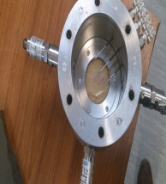
Methods
Figure 2 shows the experimental set up. CO₂ was injected into the domain , previously saturated with brine/water and the pressures of the phase were measured by pressure transducers.
The faces of the sensors were distinguished with PTFE membrane for non-wetting phase (CO₂) pressure measurement while the nylon membrane was used for brine/water phase pressure measurement.
Water saturation was measured using time domain reflectomtery (TDR) technique. TDR probes (Campbell Scientific, UK) are shown in Fig. 3C as a wave guide for the impulses generated by the reflectometer (TDR100).
While the pressure sensors and the TDR gave us the readings for the P^{c}-S measurements, the TDR further gave us the readings for the ε_{b}-S and σ_{b}-S relationships. Furthermore, silicone rubber, as a selectively-permeable membrane also gave us indication of CO₂ at various conditions.
For the dynamic drainage, constant pressure was set on the supercritical fluid pump (Teledyne Isco, Lincoln, USA)
The equilibrium or quasi static experiments were conducted by using single-pump gradient program of the supercritical fluid pump. At gradient program mode the pump was raised at 0.5 kPa every hour.
To investigate leakage of the CO₂, experiments were designed to mimic the presence of CO₂ at different depths of the subsurface . Different conditions of temperature and pressure were assigned to different depths following the standards recommended by Best (2013) and (Nordbotten et al. 2004).
Investigations were conducted in the silicate and carbonate porous media. Also, the permeation of CO₂ and N₂ under different conditions were investigated using silicone rubber.
Simple criterion was developed to distiguinsh the presence of the different gases.
C
Figure 3: Photographs showing (A) the sample holder with silica sand and sensors (B) Sensor and holder with the silicone rubber (indicated with arrow) (C) sample holder with the TDR probes showing insulated part (Cell internal diameter: 10cm, sample height: 4cm)
Figure 2: (A) High-pressure experimental set-up for the scCO₂-brine/water system (B) Schematics of TDR measurement system.

Slide 4
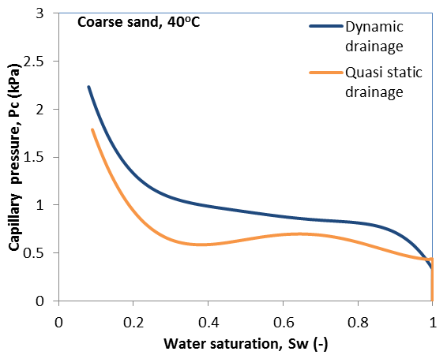
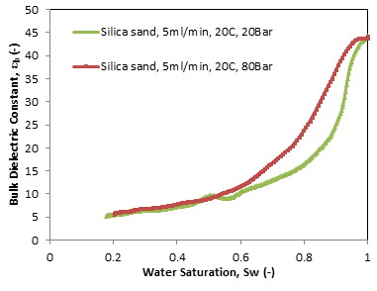
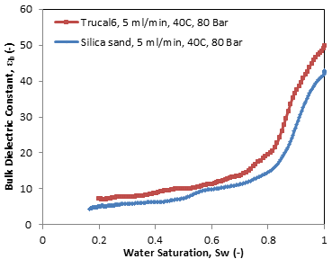
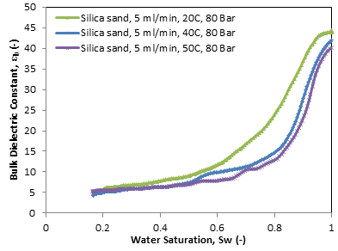
Results
Dynamic effects
Dielectric Constant
Electrical conductivity
P^{C}-S
Effects of pressure
Effects of porous media type
Effects of temperature

Slide 5
Discussions and Conclusion
Dynamic effect is present in the P^{c}-S relationships for supercritical CO₂-brine/water. However, there are no significant dynamic effects in the σ_{b}-S and ε_{b}-S relationships. This implies that the application of P^{c}-S relationships in the investigation of supercritical CO₂-brine/water must make use of the modified relation for dynamic and equilibrium (Kalaydjian (1992) and Hassanizadeh and Gray (1993)):
The injection depths of the CO₂ will determine the behaviours of the ε_{b}-S relationships. This is because the relationship was found to change with pressure and temperature. ε_{b}-S curve rises as the pressure increases. This is attributed to the likely increase in the amount of bound water as the pressure increases. Also, the ε_{b}-S curve decreases as the temperature increases in silica sand while the reverse is the case in the limestone.
Media sample type affects the ε_{b}-S and σ_{b}-S relationships. Under similar conditions, they are higher for supercritical CO₂-brine/water in limestone than silica sand.
Permeability of the silicone rubber to different gases seems unaffected by the different condition of the system. At different temperature and pressure of the CO₂ (corresponding to different depth), the permeability curves remain similar (see Figure in page 7).
Simple criterion for the detection of the permeating gas into the membrane can be achieved with the use of the mass gradient of the permeating gas (see Figure in page 8)

Slide 6
Acknowledgement
The authors would like to acknowledge the financial support of the UK CCS Research Centre (www.ukccsrc.ac.uk) in carrying out this work. The UKCCSRC is funded by the EPSRC as part of the RCUK Energy Programme

Slide 7
Permeability of the silicone rubber membrane under different conditions

Slide 8
Slope of the mass permeation rate curve against depth for different gases

