Slide 1
Supplementary data Figures
Multiparameter flow cytometric detection and quantification of senescent cells in vitro

Slide 2
Notes:
Figure S1: Characterisation of mesenchymal stem and endothelial cells. Top panel: representative histograms of surface markers expression in MSCs from flow cytometric analysis. Negative control (isotypes) is represented by the sky-blue filled histogram, and the pink-filled histogram includes the surface markers CD73, CD90, CD105. The isotype control cocktail CD34/CD45/CD14/CD20-PerCP are represented by the grey, pink and sky-blue histograms plotted together. The lower panel shows representative images of BOECs morphology (A) tube-like structure in Matrigel confirming BOECs potential for angiogenesis (B) and BOECs immunophenotyping (C).

Slide 3
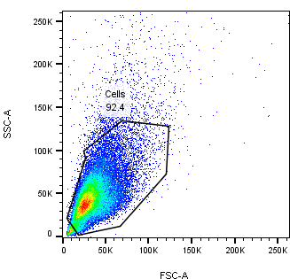
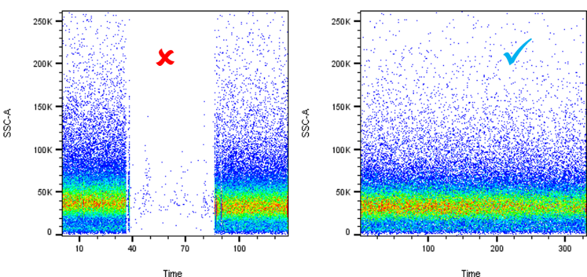
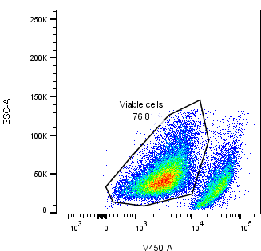
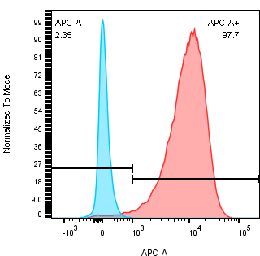
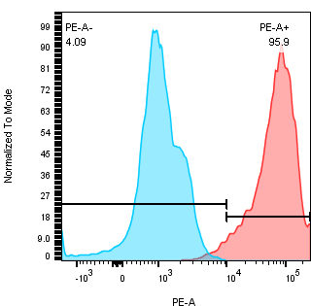
Data QC
Population of interest
Live cells gating
Singlets gating
Isotype control gating
Notes:
Figure S2: Flow cytometry gating strategy for senescent cells. Prior to processing, data quality was checked by plotting Time vs SSC to check laser status; singlets: to exclude the doublets cells; SSC vs FSC to select population of interest; and Live/Dead staining to exclude the dead cells.

Slide 4
Notes:
Figure S3: Estimated cell size in MSCs over long-term in culture. The geometric mean of the forward scatter from the flow cytometry data at time points (early, intermediate and late) was used to estimate changes in cell sizes over the period of culture. A significant increase in cell size was observed in intermediate passage when compared to cells at early passage (p < 0.05). Similarly, the cell sizes in the late passage were significantly larger than those of the early passage (p < 0.05). Data presented as standard error mean bar, asterisks denote statistical significance (**p < 0.05) by t test and n= 8.

Slide 5
Notes:
Figure S4: Quantification of senescent cells in early and late passaged BOCEs using flow cytometry method. BOECs (n=4) serially passaged over time in culture were screened for level of senescence at early and late passage by flow cytometry-based method (A) increased in SA-β-Gal activity level between the early and late passaged cells (p < 0.05), (B) elevated p16INKA4a expression level between the early and late passaged cells (p < 0.05), and (C) significantly increased in DNA damage response (γH2AX) expression in the late passaged cells when compared to those at early stage (p < 0.05). The results are presented as the mean ± s.e.m. of three independent experiments and asterisks denote statistical significance (***p < 0.05) by independent t test. The lower panel represents the correlation of cells expressing (D) p16 and SA-β-Gal markers r=0.78; p< 0.05, (E) γH2AX and SA-β-Gal markers r=0.85; p< 0.05, (F) γH2AX and p16 markers r=0.47 ; p< 0.05. There is a strong positive correlation between the markers as indicated by Spearman test.

Slide 6
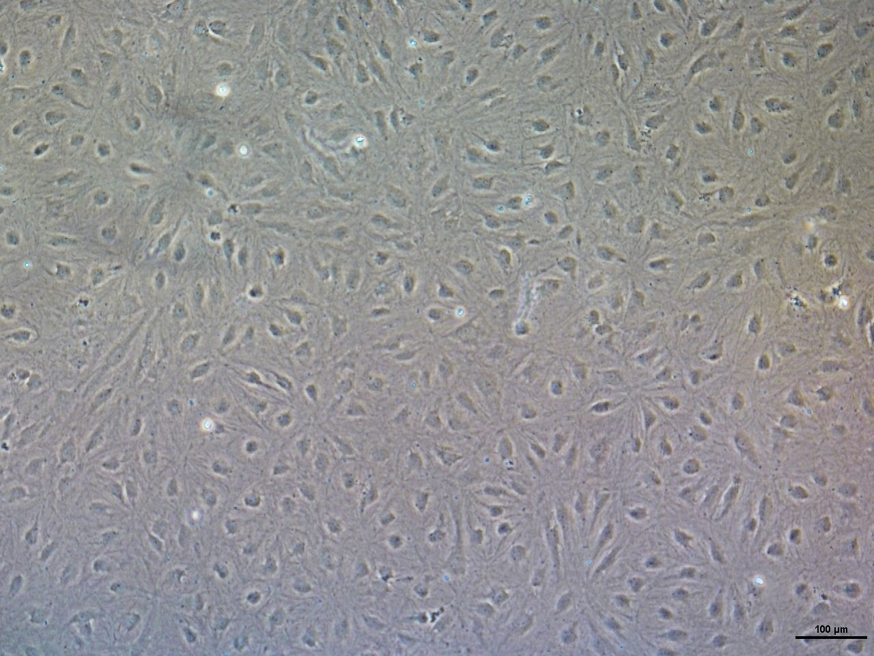
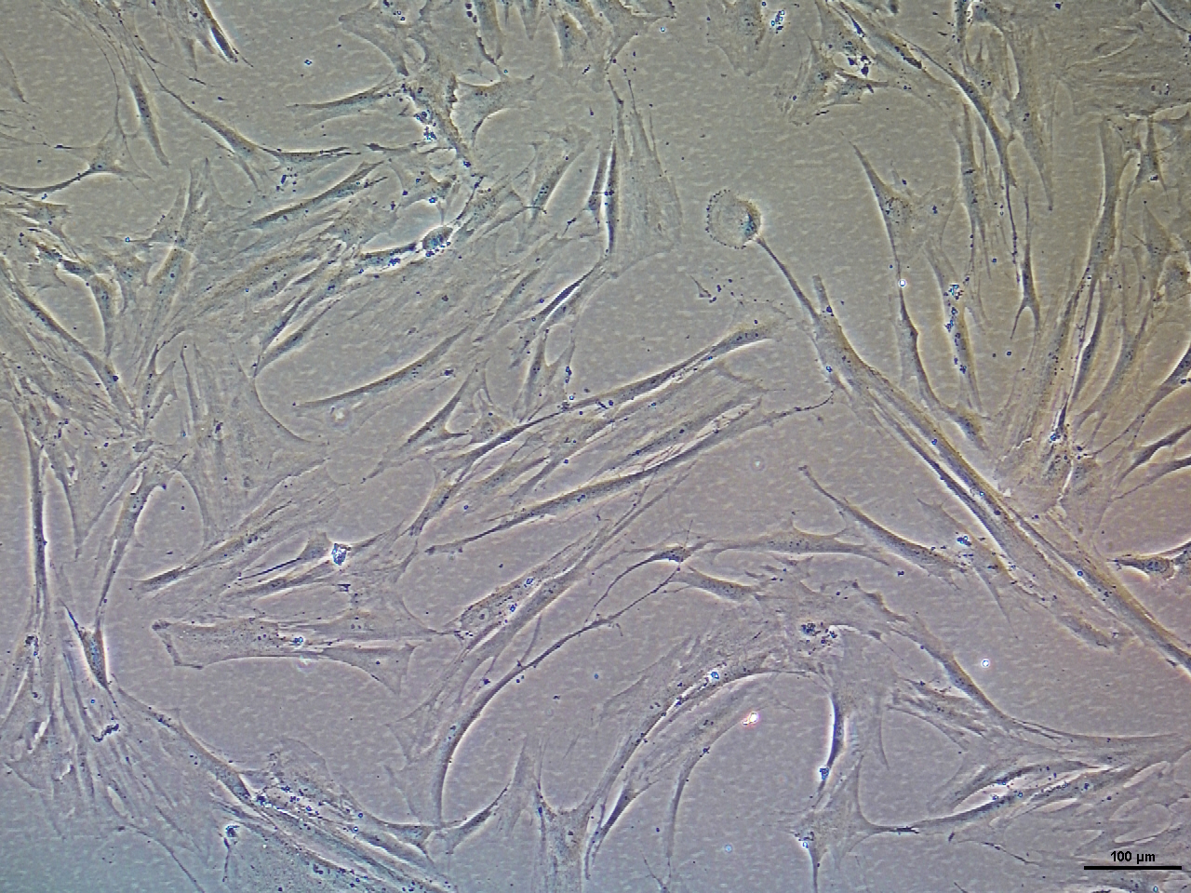
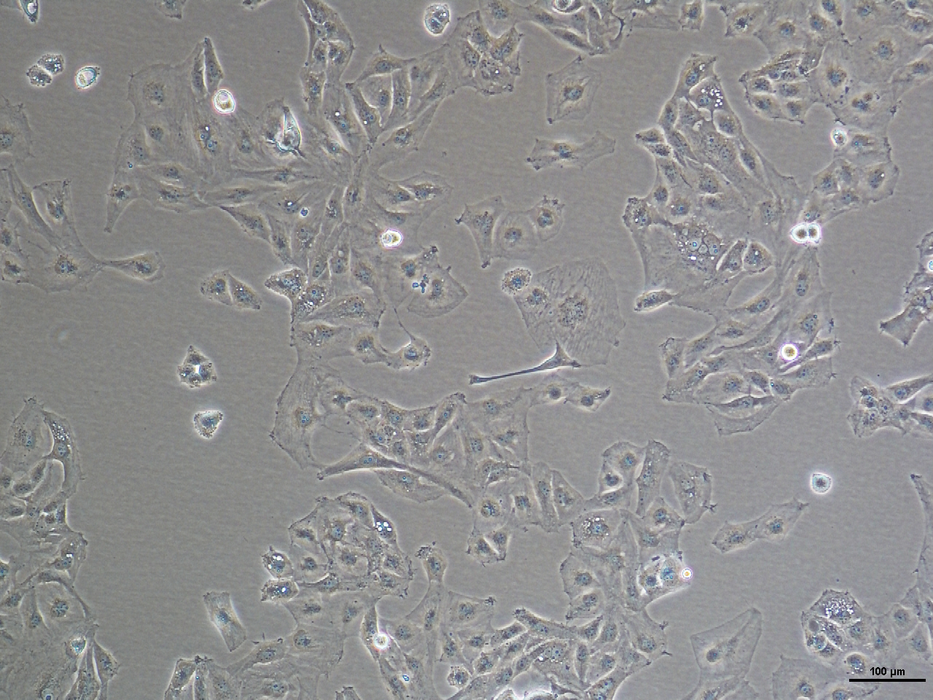
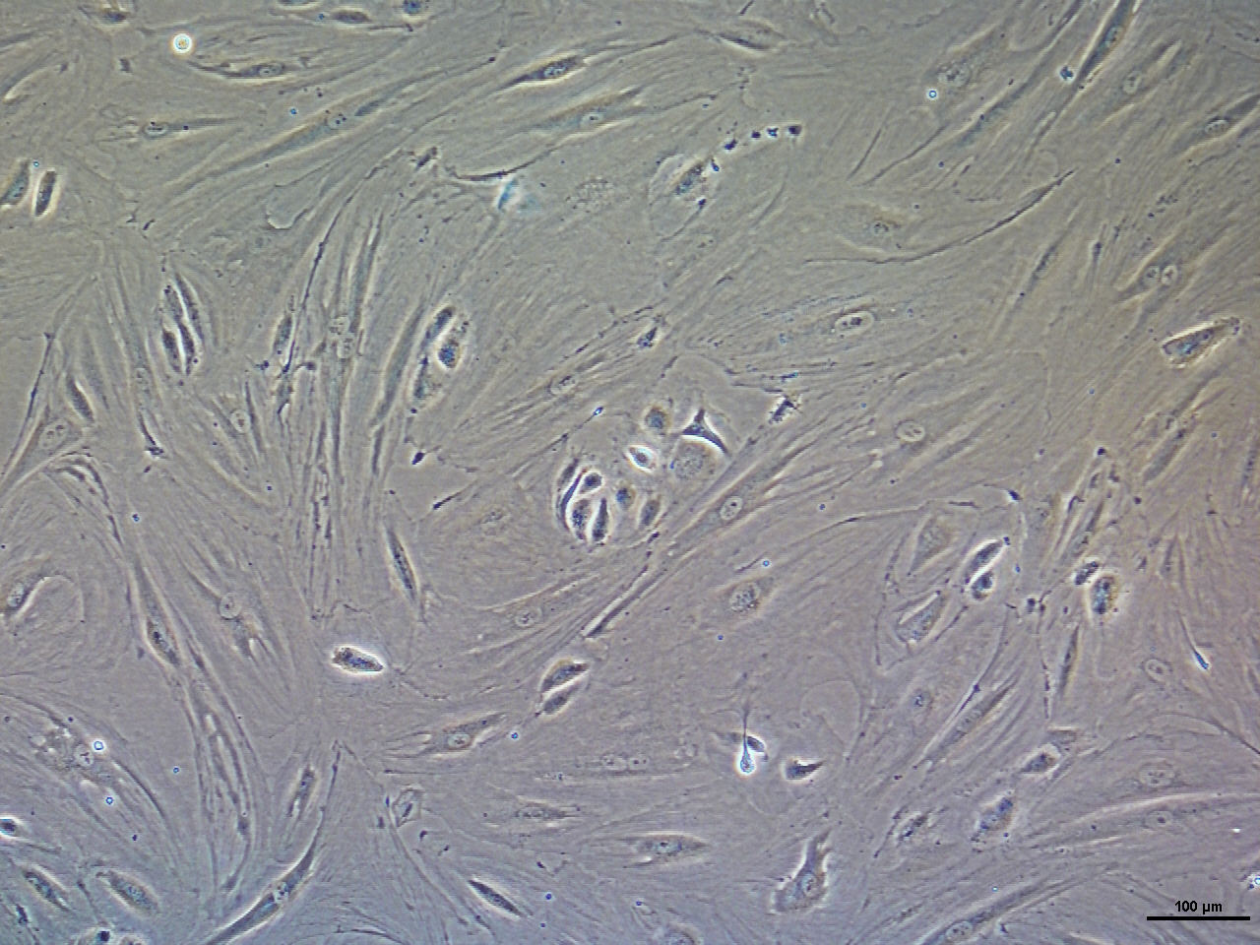
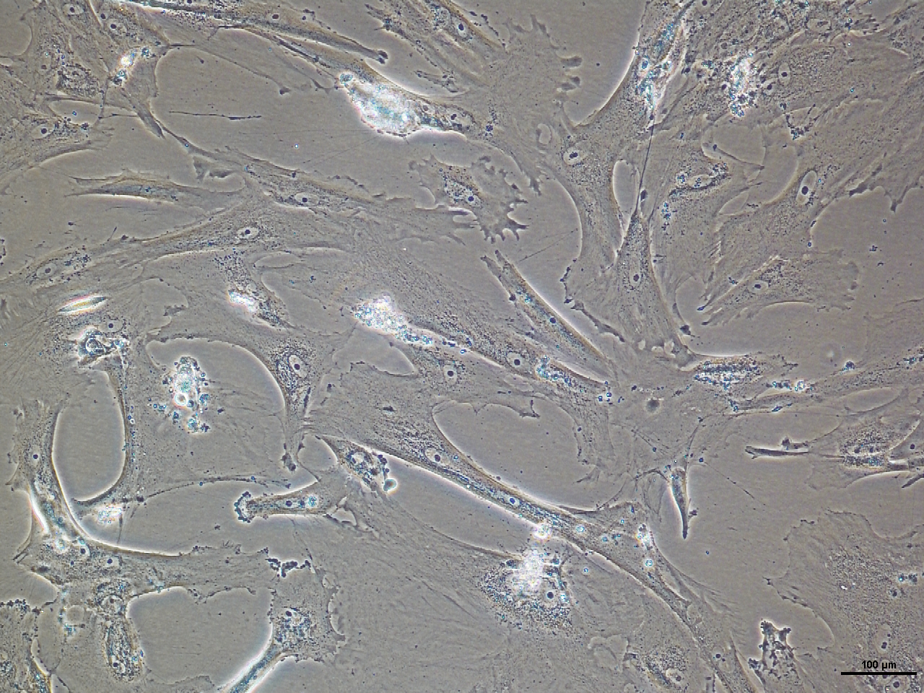
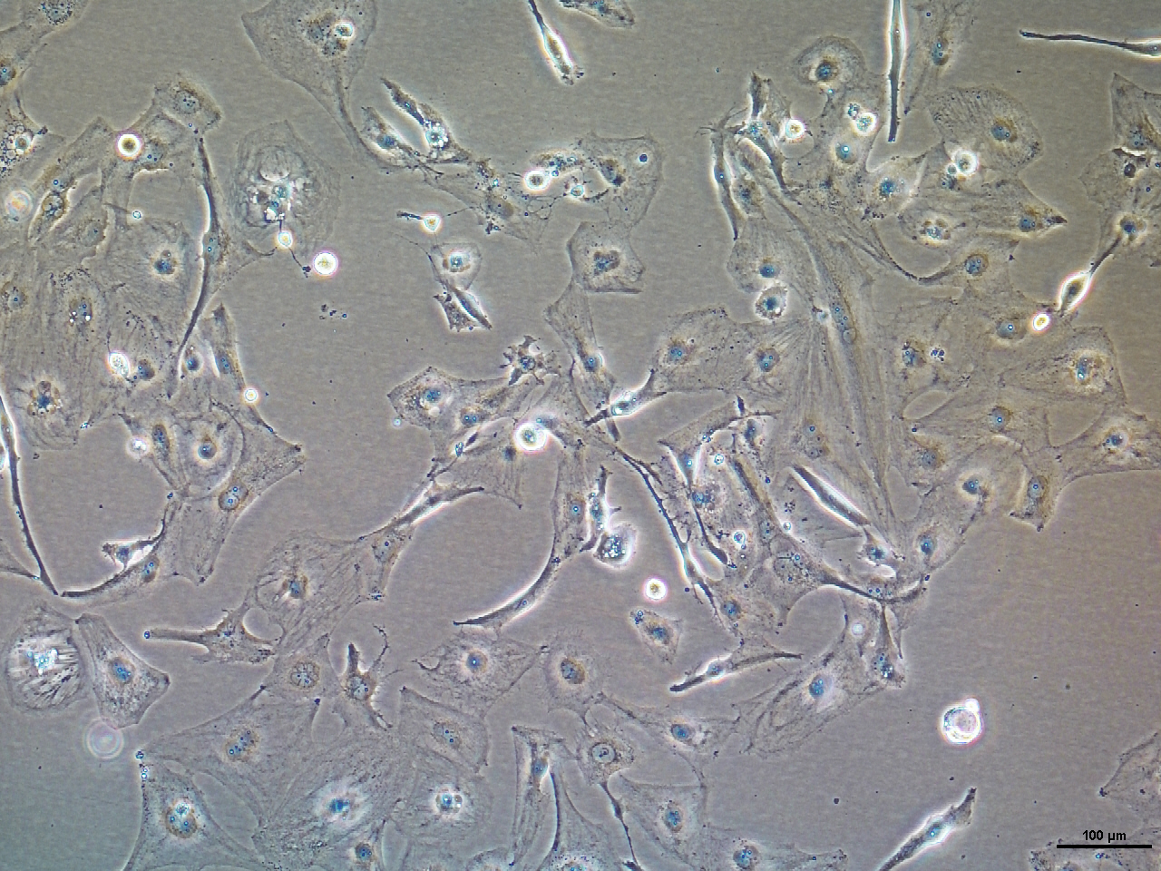
BOECs control
MSCs control
U373 control
BOECs Doxo
MSCs Doxo
U373 Doxo
Notes:
Figure S5 : Senescence-induced and proliferating cellular morphology. A representative image of proliferating and senescence-induced cells at 100 μm scale bar. The morphology of the senescence-induced cells for the three cell types and the two induction models displayed the characteristic flatten and elongated morphology of senescent cells. BOCEs (A and B); MSCs (C and D); and U373 (E and F).

Slide 7
Notes:
Figure S6: Autofluorescence of senescence-induced and proliferating cells. The autofluorescence of MSCs (n=3) were extracted from the unlabelled green channel (520 nm) of the flow cytometry data. The level of autofluorescence in both Doxo and Aza treated cells was significantly higher than in the proliferating cells (control). The results are presented as the mean ± SEM of three independent experiments and asterisks denote statistical significance (***p < 0.05) by independent t test.

Slide 8
Notes:
Figure S7: Quantification of p16 in BOECS by RT-qPCR. Real-time qPCR was used to measure the expression levels of p16 late passage stage cells (replicative senescence) and in induced-senescence. The results are presented as the mean ± s.e.m. of three independent experiments. Asterisks denote statistical significance compared to control - early stage vs late passage cells, control vs Doxo-treated cells, and control vs Aza-treated cells (**p < 0.01; ***p < 0.001,) from a t-test analysis.

Slide 9
Table 1 List of qPCR primers used in this study. (F= forward, R = reverse, bp = base pairs)
Gene | Sequence (5’-3’) | Amplicon (bp) | Efficiency (%)
p53 | F - AGTATTTGGATGACAGAA | 100 | 105
 | R - ATGTAGTTGTAGTGGATG
p21 | F - TACATCTTCTGCCTTAGT | 162 | 102
 | R - TCTTAGGAACCTCTCATT
p16 | F - CACTACCGTAAATGTCCAT | 146 | 108
 | R - GAAATGCCCACATGAATG
Ki-67 | F - AAGAACTTGGGGGCAGAAAT | 120 | 90
 | R - TGATCTTGGGTTTGGAGGAG
36B4 | F - CTCGCTTCCTGGAGGGTGTCCGC | 125 | 93
 | R - CTCCACAGACAAGGCCAGGACTCG

