Slide 1
How to Design Effective AR Retail Apps
By Liangchao Xue

Slide 2
Background

Slide 3
The problem of high-street
The growth of e-Commerce (Dover, 2019)
The impact of COVID-19 (Craven et al., 2020)
The change of consumer behaviour
(Kahn et al., 2018; Verhoef et al., 2015)

Slide 4
Digital era
Millennials
Gen Z
Baby Boomers
Gen X
Alpha Gen
Silent Gen
1928-1945
1946-1964
1965-1980
(ATKearney, 2018)

Slide 5
The problem of high-street
The growth of e-Commerce (Dover, 2019)
The impact of COVID-19 (Craven et al., 2020)
The change of consumer behaviour
(Kahn et al., 2018; Verhoef et al., 2015)
Designers’ current approach to AR is ineffective
(Xue et al., 2018, 2019)

Slide 6
Research aim
To investigate the consumer value of AR within high-street retailers, evaluate current value and explore how AR can offer consumers better in-store experiences.
We need to understand:
The value that consumers desire in a physical store environment
What kind of AR app will encourage consumers to engage in physical retail
The impact of AR on consumer behaviour and the experience that it delivers

Slide 7
METHODOLOGY
Phase 1:
Co-design Workshops
Phase 2:
Prototype Generation
Phase 3:
Experience Prototype Experiments

Slide 8
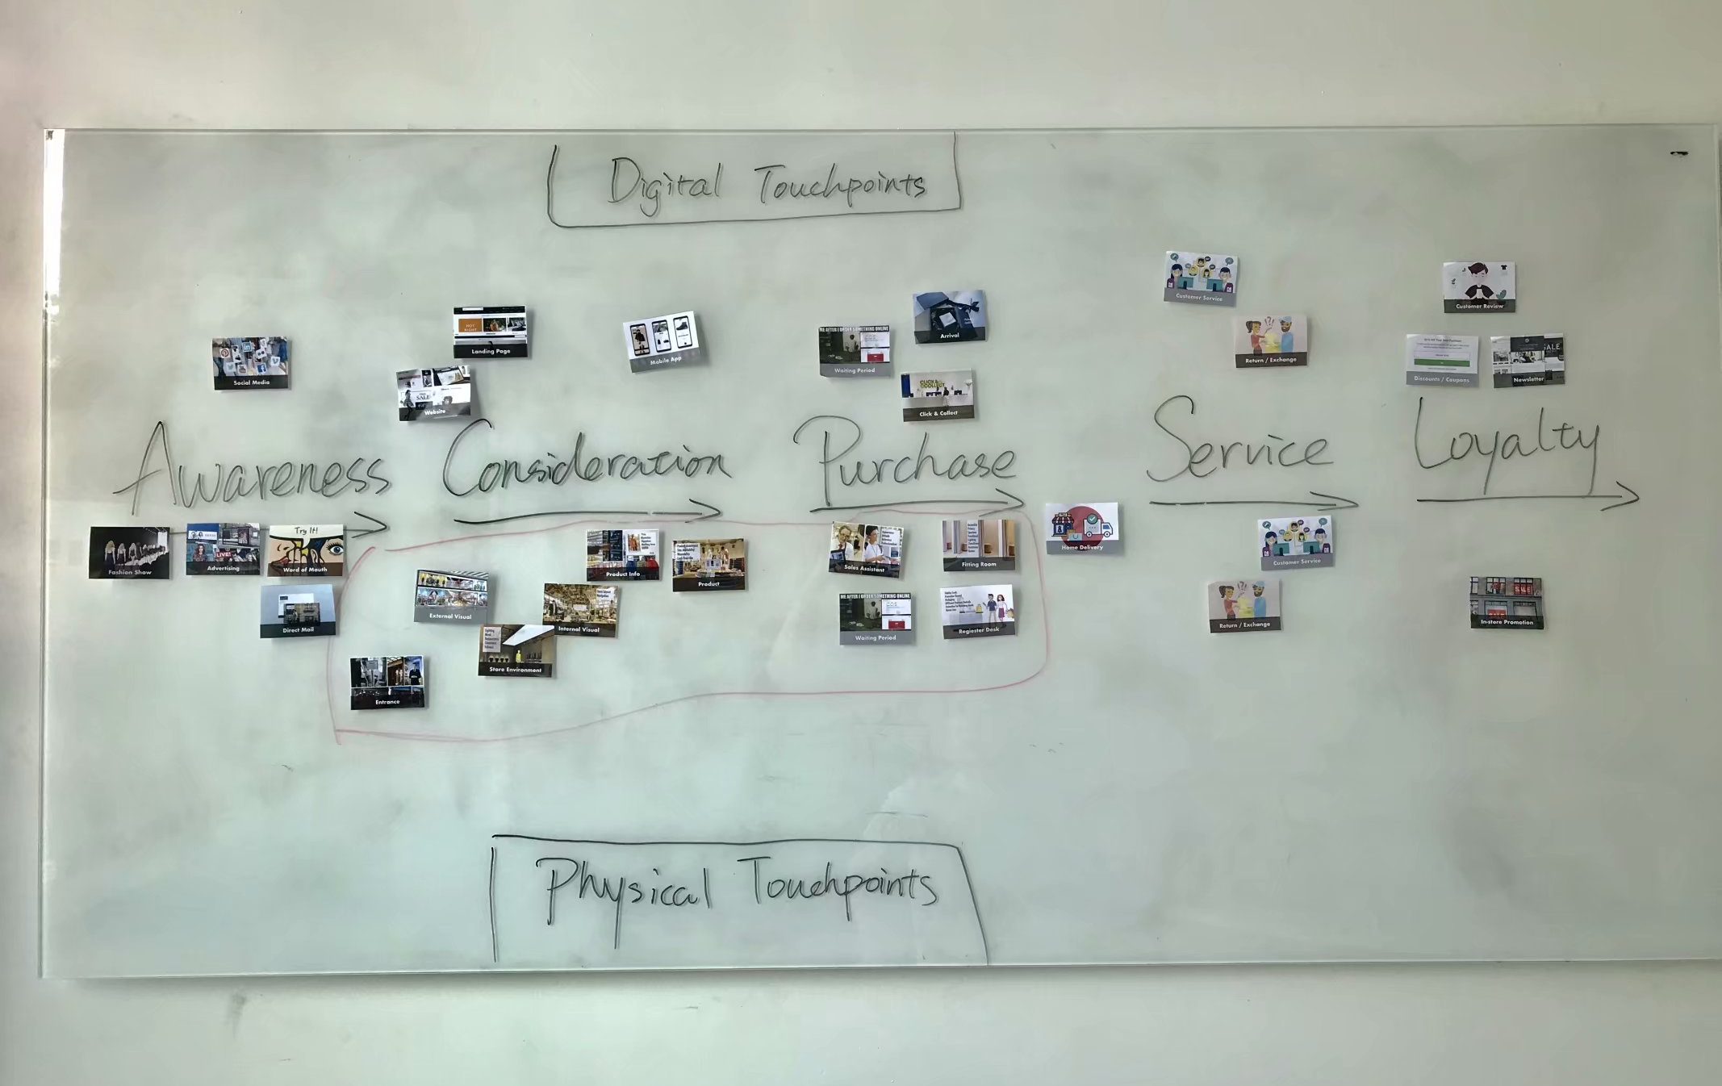
Phase 1: Co-design workshops
Evaluated Current Shopping Modes and Discovered Design Opportunities
Mapping customer journey
Identifying pain-points
Analysing results for idea generation
Tool: touch-point cards
Sample: 15 participants, 18-34 age
Mapping customer journey using touch-point card

Slide 9
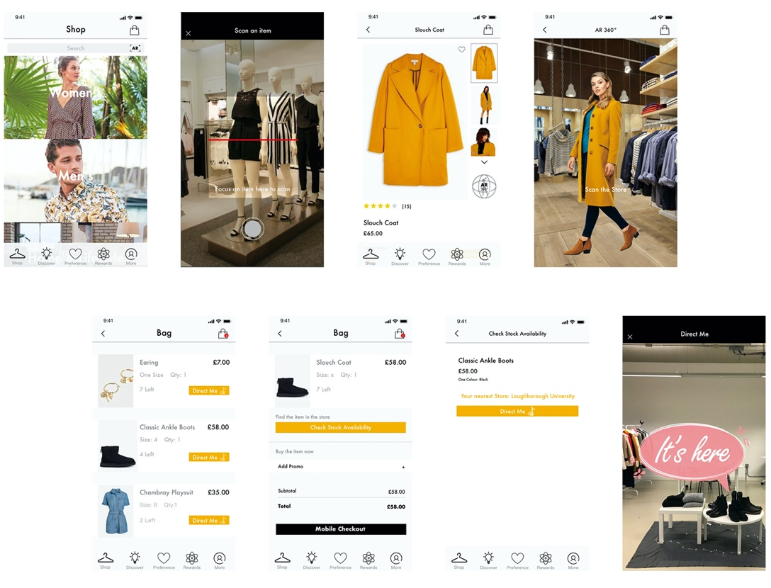
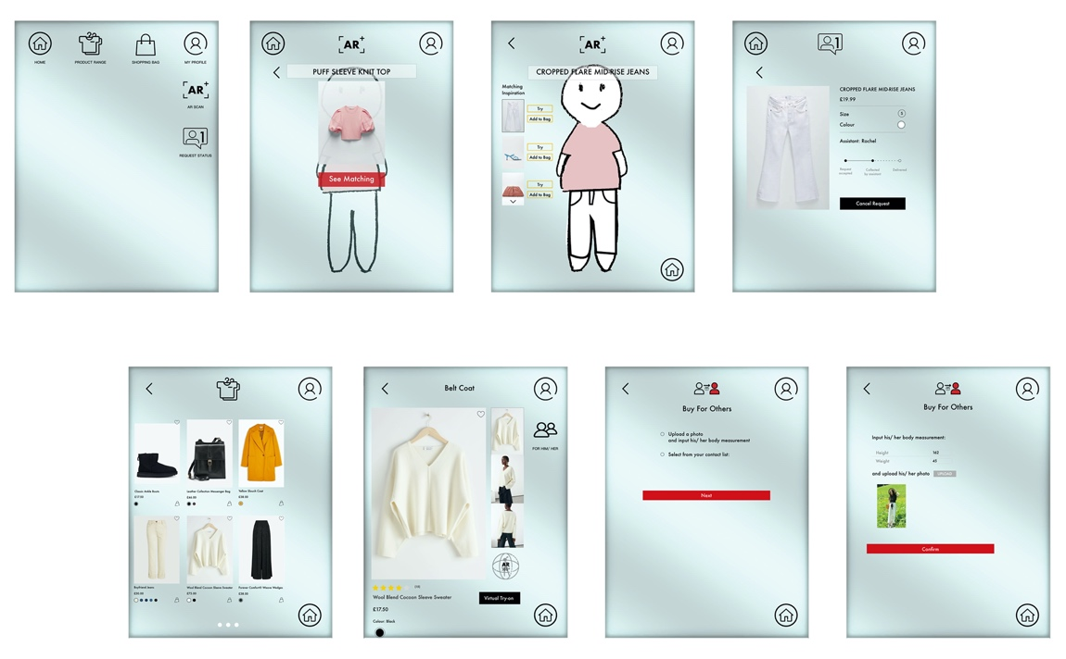
Phase 2: AR PROTOTYPE DESIGN
Design Two Concept Apps
Based on the consumer’s pain-points revealed from phase one
UX design flow

Slide 10
Phase 2: AR PROTOTYPE DESIGN
Design Two Concept Apps
Based on the consumer’s pain-points revealed from phase one
UX design flow

Slide 11
Phase 2: AR PROTOTYPE DESIGN
Design Two Concept Apps
Based on the consumer’s pain-points revealed from phase one
UX design flow
Non-AR Prototypes to Compare:
Non-AR App VS. AR branded App
Non-AR Touch Screen VS. Magic Mirror

Slide 12
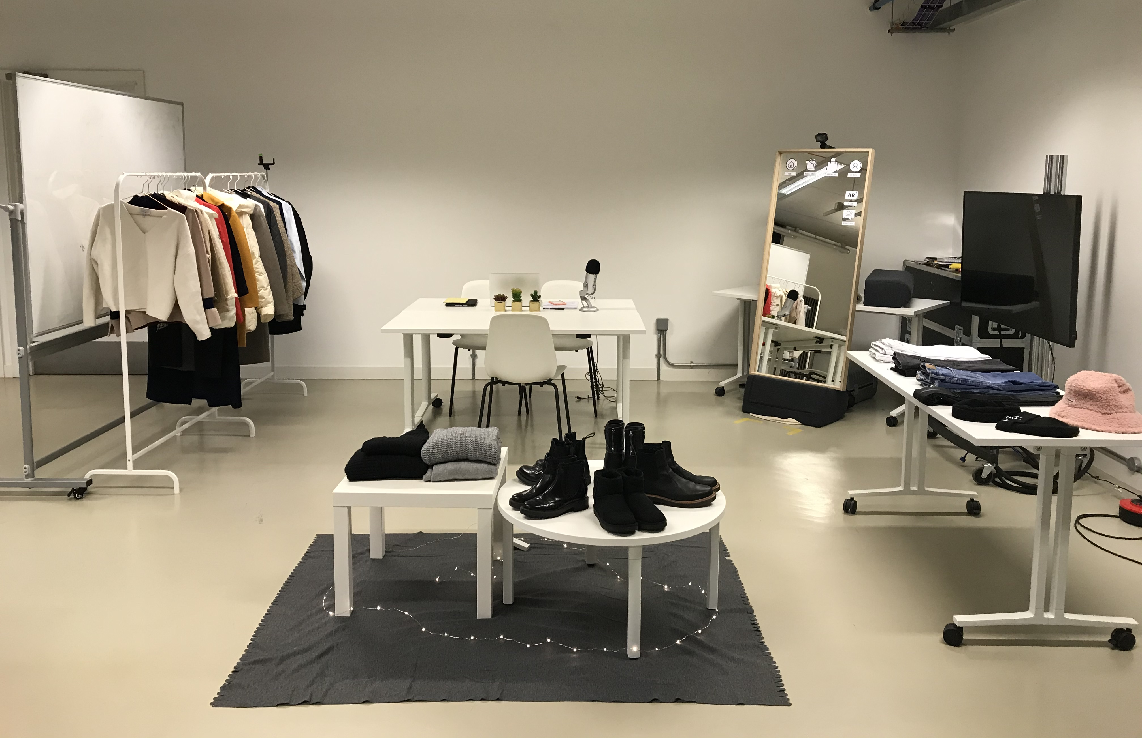
Phase 3: Experience prototype experiments
Explored and Evaluated the Prototypes
42 experience prototype sessions:
11 in AR App, 11 in AR Mirror, 10 in non-AR app, and 10 in non-AR screen
Targeted consumers aged between 18-34
Complete three tasks for each prototype
Mock-up shop in experience prototype experiment

Slide 13
Phase 3: Experience prototype experiments
Method | Data Collection | Data Analysis
Quantitative | Performance Measurement: task success, task errors, and task time | Cross-Comparison Groups – Mann-Whitney U Test
 | Satisfaction Measurement: SUS test (5-point semantic differential scales)
 | Beliefs, Attitude, and Intention: online questionnaire (7-point Likert scale descriptors and 7-point semantic differential scales )
Qualitative | Post-interaction interviews | Thematic Analysis – NVivo 12

Slide 14
results

Slide 15
Results
Significant level of Man-Whitney U test
Prototype | Ease of Use | Usefulness | Enjoyment | Intention | Attitude -Performance | Attitude -Time
AR App VS. Non-AR Apps | P=.31 | P=.28 |  |  | P=.43 | P=1.00
AR Mirror VS. Non-AR Screen | P=.51 | P=.31 |  | P=.11 | P=.28 | P=.09
P=.03
P=.04
P=.01
P<0.05: significant difference
Comparison between the Means of AR prototypes and Non-AR prototypes

Slide 16
Ar vs. non-ar versions
 | AR Versions | Non-AR Versions
Attitude (positive) | ✓
Easy to Use |  | ✓
Usefulness | ✓
Enjoyment | ✓
Intention | ✓
Enjoyment is the key of AR, but it WOULD NOT be the trigger to use the AR App or AR Mirror
Intention – novelty effect, but participants are not confident with the AR outcome (AR try-on, navigation)

Slide 17
Ar app & magic mirror
 | AR App | Magic Mirror
Most influential factor | Perceived Usefulness | Perceived Ease of Use
More intention to use | ✓
Perceived Enjoyment has indirect effect on behavioural intention mediated by attitude
Functional-oriented applications are rated more positively than enjoyment-oriented ones

Slide 18
conclusion

Slide 19
Design solutions for in-store AR retail
Design Requirements of In-Store AR Solutions
Design Aim | AR Solutions
Offer Convenience | 1. Personal account → preference → suggest the style and size
Improve Accessibility | 2. Keep the procedure simple
Up-to-Date Information | 3. Update the number of items in stock 4. Update the navigation under store merchandising direction
Improve Modelling Accuracy | 5. Show size differences when virtual trying-on
Improve the Content Richness | 6. Offer ‘Buy for others’ option
Seamless Shopping Experience | 7. AR functions should be consistent with the supporting facilities in the store.
 | 8. Integrate with other high-tech equipment (i.e. Self-check-out; AI assistant)
@Liangchao Xue

Slide 20
REFERENCES
ATKearney. (2018). The future of shopping centers. ATKearney. Retrieved from http://www.whitehutchinson.com/leisure/articles/FutureOfShoppingCenters.shtml
Craven, M., Liu, L., Mysore, M., & Wilson, M. (2020). COVID-19: Implications for business. McKinsey. https://www.mckinsey.com/business-functions/risk/our-insights/covid-19-implications-for-business
Dover, S. (2019). British Lifestyles: A New Understanding of Corporate Ethics - UK - April 2019: Fashion. Mintel. http://academic.mintel.com/display/952828/?highlight
Kahn, B. E., Inman, J. J., & Verhoef, P. C. (2018). Introduction to special issue: Consumer response to the evolving retailing landscape. Journal of the Association for Consumer Research, 3(3), 255–259.
Verhoef, P. C., Kannan, P. K., & Inman, J. J. (2015). From multi-channel retailing to omni-channel retailing: introduction to the special issue on multi-channel retailing. Journal of Retailing, 91(2), 174–181.
Xue, L., Parker, C. J., & Hart, C. (2019). How To Engage Fashion Retail With VR: A Consumer Perspective. 5th International Augmented and Virtual Reality Conference.
Xue, L., Parker, C. J., & McCormick, H. (2018). A Virtual Reality and Retailing Literature Review: Current Focus, Underlying Themes and Future Directions. 4th International AR & VR Conference 2018: The Power of AR & VR for Business.

Slide 21
Thank you
@Liangchao Xue

