Slide 1
Triple sensing scheme based on nonlinear coupled micromachined resonators
Zhengliang Fang, Stephanos Theodossiades and Amal Z. Hajjaj
Wolfson School of Mechanical, Electrical and Manufacturing Engineering, Loughborough, LE11 3TU, UK
E-mail: Z.Fang@lboro.ac.uk , s.theodossiades@lboro.ac.uk , a.a.hajjaj@lboro.ac.uk
NODYCON 2023, June 18-22, 2023, Rome, Italy
Notes:
Hello everyone, I’m very honor to present our spiring research today. Our research title is Triple sensing scheme based on nonlinear coupled micromachined resonators, my name is Zhengliang, I’m from Loughborough University.

Slide 2
Outline
□ Introduction
□ Sensor Modelling
□ Results and Discussions
□ Conclusions
Outline
1
NODYCON 2023, June 18-22, 2023, Rome, Italy
Notes:
Before I start the main content, I would like to give the structure of my presentation. Firstly, I will introduce some background about the MEMS multi-sensing technique, and give our motivation of the project. After that, I will show the sensor structure and methodology with corresponding equations. Then, the simulation results and discussions will be demonstrated. At last, I will conclude the whole research.

Slide 3
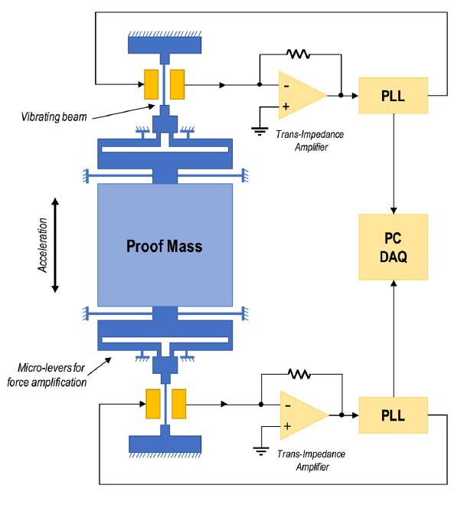
Introduction – MEMS Sensor
Thermal Conductivity
Gas Sensor
Struk et al., 2018
Micro-Gravimetric Sensor
Al-Ghamdi et al., 2019
MEMS Accelerometer
Mustafazade et al., 2020
Section 1: Introduction
2
NODYCON 2023, June 18-22, 2023, Rome, Italy
Notes:
Recently, the MEMS sensor receives remarkable success. By taking advantage of their proven high sensitivity, low power consumption, miniaturization design, and long-term stability, MEMS sensors have been utilized in a wide range of applications including biosensors, medical treatment, gas sensors, gyroscopes, accelerometers and mass sensors. Numerous commercial sensor products prove their value and replace the traditional sensors.

Slide 4
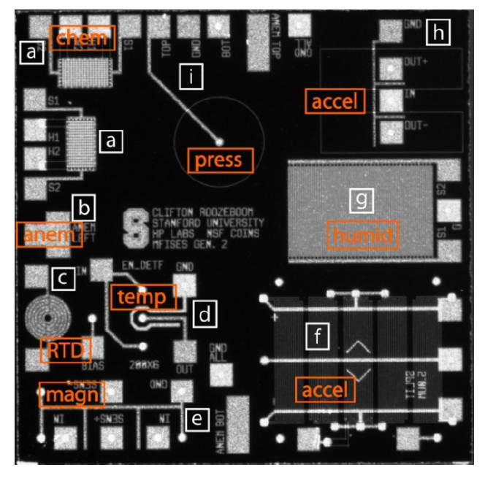
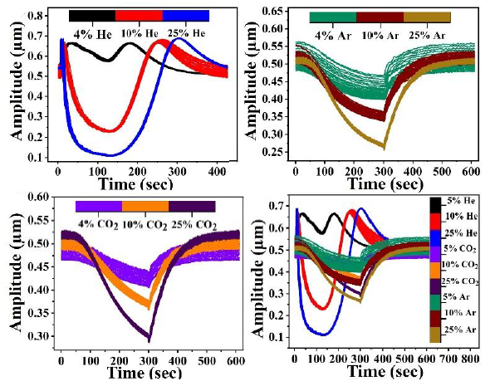
Introduction – Multiple Parameter Sensing
Multifunctional Integrated Sensor Chip
Roozeboom et al., 2015
Gas Sensing Response used
In Machine Learning Algorithm
Yaqoob et al., 2022
Section 1: Introduction
3
NODYCON 2023, June 18-22, 2023, Rome, Italy
Notes:
The on multiple parameters sensing is also a fascinating topic. The traditional solution for multiple parameter sensing is integrating multiple kinds of sensors in a chip which leads to high cost and power consumption. To reach the multiple parameter sensing on single device, some researchers adopt machine learning algorithm to distinguish different stimuli. In this literature, researches gather the sensing response for three kinds of gases as dataset and yield a high accuracy algorithm for multiple gas sensing.

Slide 5
Introduction – Motivations and Objectives
□ The multiple sensing could be achieved through combining multiple kinds of sensing techniques, which bring in multiple types of perturbations simultaneously.
□ Through monitoring the system’s resonance frequencies variation due to different perturbations, the multiple sensing could be optimized.
Section 1: Introduction
4
NODYCON 2023, June 18-22, 2023, Rome, Italy
Notes:
During our research, we raised a solution for the multiple sensing based on the special sensor design. We combine different kinds of sensing techniques into single coupled structure and monitor them through the system’s resonance frequencies simultaneously, hence generates the special MEMS structure which has the ability to detect multi type parameters.

Slide 6
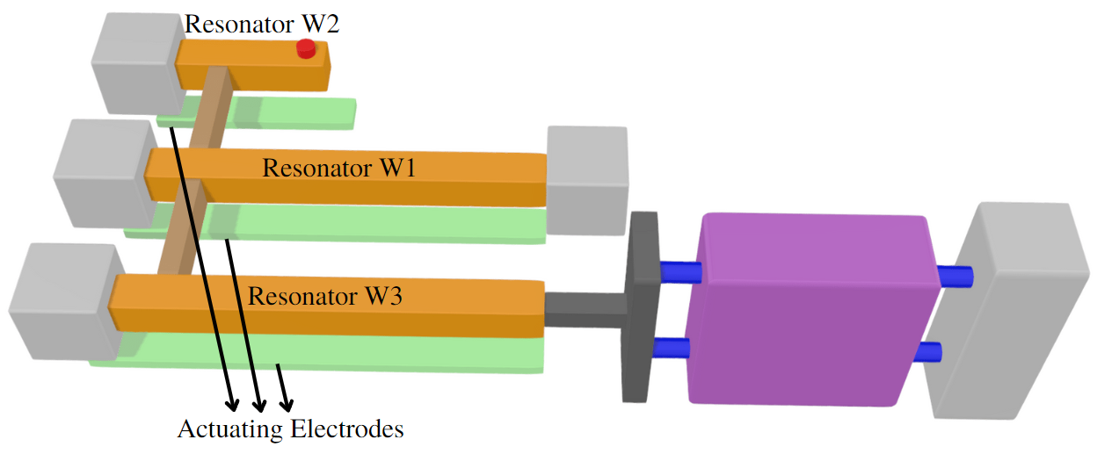
Sensor Modelling – Structure & Methodology
Section 2: Sensor Modelling
5
NODYCON 2023, June 18-22, 2023, Rome, Italy
Notes:
This is the main structure of our sensor. This sensor comprises a weakly coupled-resonator, including a cantilever and two bridge resonators with thin coupling beam weakly couples them. All three resonators are driven electrostatically by a DC polarization actuating V_{DC}. And the AC harmonic actuation V_{AC} is given on one of them depends on the actuation theory. On this coupled structure, we combine three kinds of sensing technique.

Slide 7
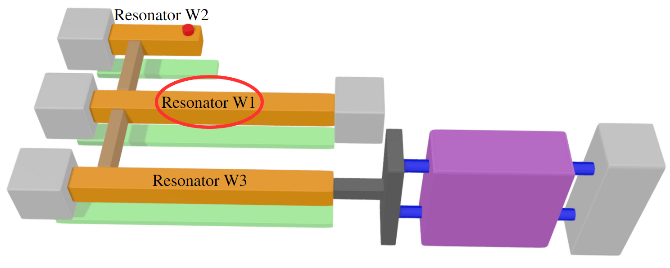
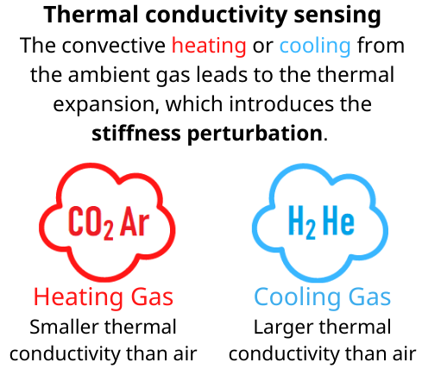
Sensor Modelling – Structure & Methodology
Section 2: Sensor Modelling
6
NODYCON 2023, June 18-22, 2023, Rome, Italy
Notes:
For the bridge resonator W1 in the middle, the thermal conductivity sensing technique is applied. The resonator W1 will be heated electrostatically and experience the convectively heating or cooling due to the change of ambient thermal conductivity, this would lead to the thermal expansion, hence introducing the stiffness perturbation to bridge.

Slide 8
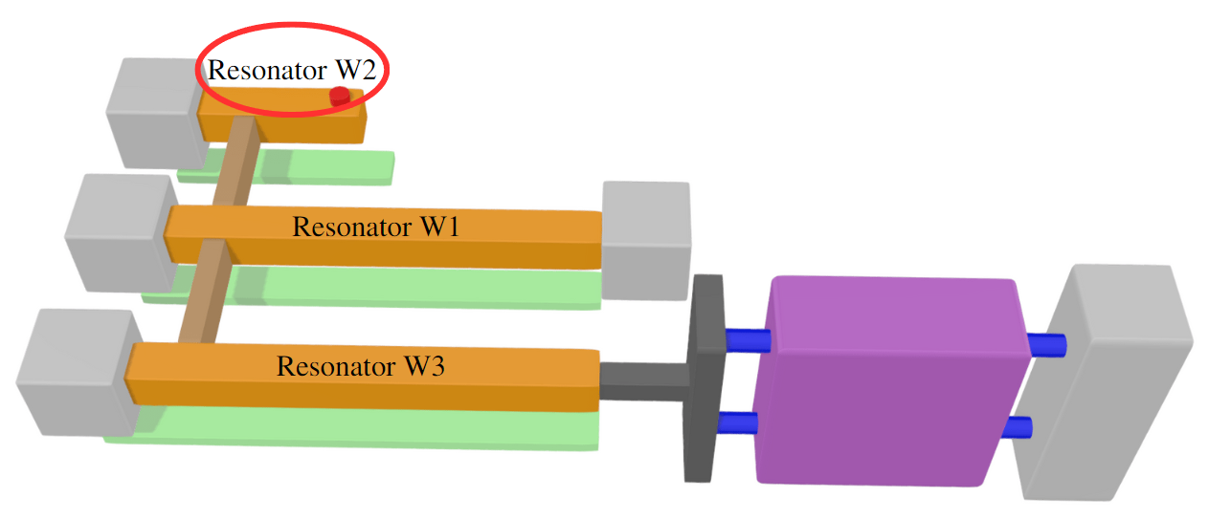
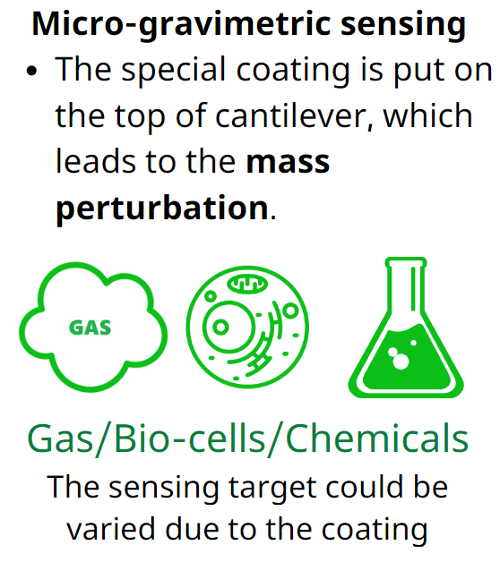
Sensor Modelling – Structure & Methodology
Section 2: Sensor Modelling
7
NODYCON 2023, June 18-22, 2023, Rome, Italy
Notes:
For the cantilever resonator w2, the mass sensing technique is achieved by the coating on the top, which is noted as red. By absorbing the target material, the mass perturbation will be introduced on cantilever. The sensing target could be gas, bio-cells and chemicals based on the coating material.

Slide 9
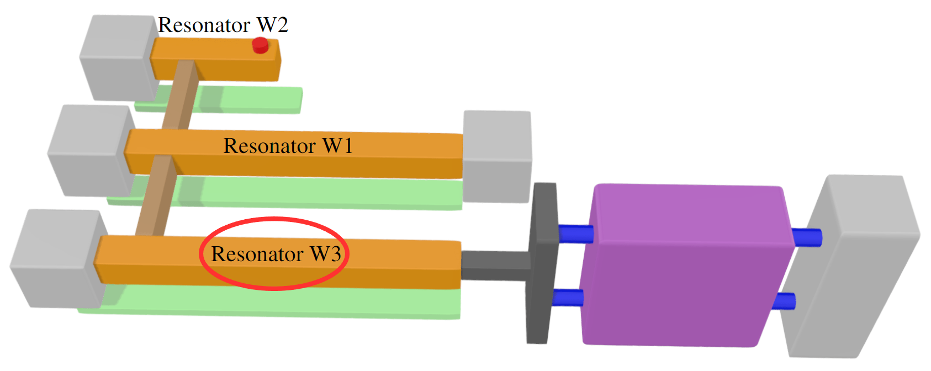
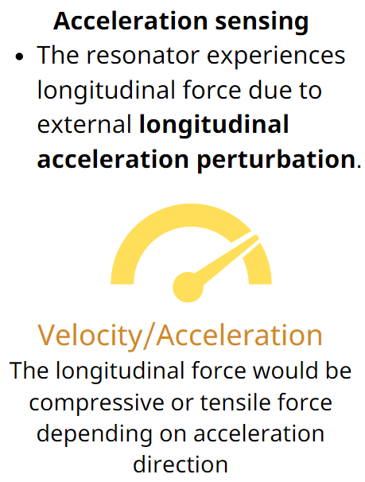
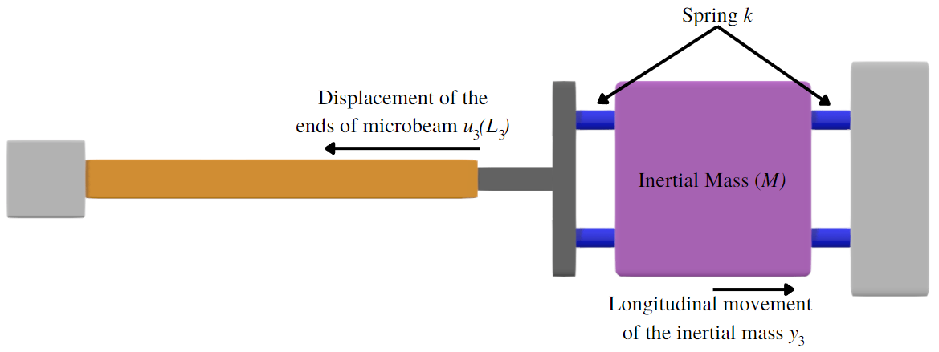
Sensor Modelling – Structure & Methodology
Section 2: Sensor Modelling
8
NODYCON 2023, June 18-22, 2023, Rome, Italy
Notes:
The bridge resonator W3, which connects to inertial mass, is used to detect longitudinal acceleration. When the external longitudinal acceleration is applied to the sensor, the inertial mass generates a longitudinal compressive or tensile force depending on the acceleration direction. This induced force influences significantly the resonator $W_{3}$'s axial force, hence its resonance frequency. Now three different sensing techniques are perfect combined in this structure, bring the mass, stiffness, and acceleration perturbations respectively.

Slide 10
Sensor Modelling – Sensor Equations
Euler-Bernoulli Equations:
$EI{\tilde{w}}_{1}^{′′′′}+ρA\ddot{{\tilde{w}}_{1}}+{\tilde{c}}_{1}\dot{{\tilde{w}}_{1}}+\left[\tilde{N}−\frac{EA}{2L_{1}}\int_{0}^{L_{1}}{{\left({\tilde{w}}_{1}^{′}\right)}^{2}dx}\right]{\tilde{w}}_{1}^{′′}+{\tilde{k}}_{r}\left({\tilde{w}}_{1}^{′}\left({\tilde{X}}_{c}\right)−{\tilde{w}}_{2}^{′}\left({\tilde{X}}_{c}\right)\right)δ^{′}\left(\tilde{x}−{\tilde{X}}_{c}\right)−{\tilde{k}}_{r}\left({\tilde{w}}_{1}^{′}\left({\tilde{X}}_{c}\right)−{\tilde{w}}_{3}^{′}\left({\tilde{X}}_{c}\right)\right)δ^{′}\left(\tilde{x}−{\tilde{X}}_{c}\right) =\frac{1}{2}ε_{0}\frac{b{\left[V_{DC1}+V_{AC1}∗\cos\left({\tilde{Ω}}_{1}\tilde{t}\right)\right]}^{2}}{{\left(d_{1}−{\tilde{w}}_{1}\right)}^{2}}$
$EI{\tilde{w}}_{2}^{′′′′}+\left(ρA+\tilde{m}δ\left(\tilde{x}−{\tilde{X}}_{m}\right)\right)\ddot{{\tilde{w}}_{2}}+{\tilde{c}}_{2}\dot{{\tilde{w}}_{2}}+k_{r}\left({\tilde{w}}_{2}^{′}\left({\tilde{X}}_{c}\right)−{\tilde{w}}_{1}^{′}\left({\tilde{X}}_{c}\right)\right)δ^{′}\left(\tilde{x}−{\tilde{X}}_{c}\right)=\frac{1}{2}ε_{0}\frac{b{\left[V_{DC2}+V_{AC2}∗\cos\left({\tilde{Ω}}_{2}\tilde{t}\right)\right]}^{2}}{{\left(d_{2}−{\tilde{w}}_{2}\right)}^{2}}$
$EI{\tilde{w}}_{3}^{′′′′}+ρA\ddot{{\tilde{w}}_{3}}+{\tilde{c}}_{3}\dot{{\tilde{w}}_{3}}+\frac{1}{2}\left[MW_{a}−\frac{1}{2}k\int_{0}^{L_{3}}{{\left({\tilde{w}}_{3}^{′}\right)}^{2}dx}\right]{\tilde{w}}_{3}^{′′}+{\tilde{k}}_{r}\left({\tilde{w}}_{3}^{′}\left({\tilde{X}}_{c}\right)−{\tilde{w}}_{1}^{′}\left({\tilde{X}}_{c}\right)\right)δ^{′}\left(\tilde{x}−{\tilde{X}}_{c}\right)=\frac{1}{2}ε_{0}\frac{b{\left[V_{DC3}+V_{AC3}∗\cos\left({\tilde{Ω}}_{3}\tilde{t}\right)\right]}^{2}}{{\left(d_{3}−{\tilde{w}}_{3}\right)}^{2}}$
${\tilde{w}}_{1}$, ${\tilde{w}}_{2}$, and ${\tilde{w}}_{3}$ represent three resonators
Section 2: Sensor Modelling
9
NODYCON 2023, June 18-22, 2023, Rome, Italy
Notes:
These Euler-Bernoulli equations represent the system motions. The W1, W2, and W3 are transverse deflections for three resonators respectively. The detailed derivation process is omitted here, if you are interested with them, you could contact us with e-mail later.

Slide 11
Sensor Modelling – Sensor Equations
After nondimensionalising and discretising using Galerkin procedure:
$$\left(\frac{∂^{2}u_{1}}{∂t^{2}}+c_{1n}\frac{∂u_{1}}{∂t}+\int_{0}^{1}{φ_{1}φ_{1}^{′′′′}dx}u_{1}\left(1+δk\right)+k_{r}\left[u_{1}{\left(φ_{1}^{′}\left(X_{c}\right)\right)}^{2}−u_{2}φ_{1}^{′}\left(X_{c}\right)φ_{2}^{′}\left(X_{c}\right)\right]+k_{r}\left[u_{1}{\left(φ_{1}^{′}\left(X_{d}\right)\right)}^{2}−u_{3}φ_{1}^{′}\left(X_{d}\right)φ_{3}^{′}\left(X_{d}\right)\right]\right)∗\left(1−2u_{1}\int_{0}^{1}{φ_{1}^{3}dx}+u_{1}^{2}\int_{0}^{1}{φ_{1}^{4}dx}\right)−α_{1}\int_{0}^{1}{{φ_{1}^{′}}^{2}dx}\left(u_{1}^{3}\int_{0}^{1}{φ_{1}^{′′}φ_{1}dx}−2u_{1}^{4}\int_{0}^{1}{φ_{1}^{′′}φ_{1}^{2}dx}+u_{1}^{5}\int_{0}^{1}{φ_{1}^{′′}φ_{1}^{3}dx}\right)=α_{2}{\left[V_{dc2}+V_{ac2}\cos\left(Ω_{2}t\right)\right]}^{2}\int_{0}^{1}{φ_{1}dx}\left(1\right)$$
$$\left(\frac{∂^{2}u_{2}}{∂t^{2}}\left(1+δm\left(x−X_{m}\right)\right)+c_{2n}\frac{∂u_{2}}{∂t}+\int_{0}^{R_{L1}}{φ_{2}φ_{2}^{′′′′}dx}u_{2}+k_{r}\left[u_{2}{\left(φ_{2}^{′}\left(X_{c}\right)\right)}^{2}−u_{1}φ_{1}^{′}\left(X_{c}\right)φ_{2}^{′}\left(X_{c}\right)\right]\right)∗\left(R_{d1}^{2}−2R_{d1}u_{2}\int_{0}^{R_{L1}}{φ_{2}^{3}dx}+u_{2}^{2}\int_{0}^{R_{L1}}{φ_{2}^{4}dx}\right)=α_{2}{\left[V_{dc2}+V_{ac2}\cos\left(Ω_{2}t\right)\right]}^{2}\int_{0}^{R_{L1}}{φ_{2}dx}(2)$$
$$\left(\frac{∂^{2}u_{3}}{∂t^{2}}+c_{3n}\frac{∂u_{3}}{∂t}+\int_{0}^{R_{L2}}{φ_{3}φ_{3}^{′′′′}dx}u_{3}−k_{r}\left[u_{3}{\left(φ_{3}^{′}\left(X_{c}\right)\right)}^{2}+u_{1}φ_{3}^{′}\left(X_{c}\right)φ_{1}^{′}\left(X_{c}\right)\right]\right)∗\left(R_{d2}^{2}−2R_{d2}u_{3}\int_{0}^{R_{L2}}{φ_{3}^{3}dx}+u_{3}^{2}\int_{0}^{R_{L2}}{φ_{3}^{4}dx}\right)+\left[\frac{MδW_{a}L_{1}^{2}}{2EI}−K_{non}\int_{0}^{R_{L2}}{{\left(w_{3}^{′}\right)}^{2}dx}\right]∗\left(R_{d2}^{2}u_{3}^{3}\int_{0}^{R_{L2}}{φ_{3}^{′′}φ_{3}dx}−2R_{d2}u_{3}^{4}\int_{0}^{R_{L2}}{φ_{3}^{′′}φ_{3}^{2}dx}+u_{1}^{5}\int_{0}^{R_{L2}}{φ_{3}^{′′}φ_{3}^{3}dx}\right)=α_{3}{\left[V_{dc3}+V_{ac3}\cos\left(Ω_{3}t\right)\right]}^{2}\int_{0}^{R_{L2}}{φ_{3}dx}(3)$$
Equation 1: Bridge resonator $w_{1}$ with stiffness perturbation $δk$
Equation 2: Cantilever resonator $w_{2}$ with mass perturbation $δm$
Equation 3: Bridge resonator $w_{3}$ with acceleration perturbation $δW_{a}$
Section 2: Sensor Modelling
10
NODYCON 2023, June 18-22, 2023, Rome, Italy
Notes:
After nondimensionalising and discretising using Galerkin procedure, the governing non-dimensional equations are written as shown. The equation 1 on above represents the motion of bridge w1 with stiffness perturbation delta k, while the medium equation shows the motion of cantilever w2 with mass perturbation delta m, and the below equation gives the motion of bridge w3 with acceleration perturbation delta Wa. The following simulation is based on these equations.

Slide 12
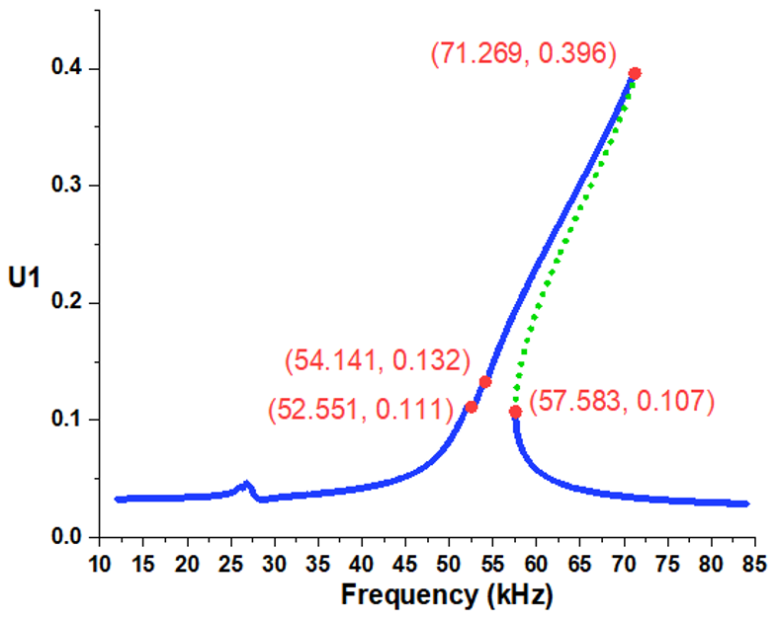
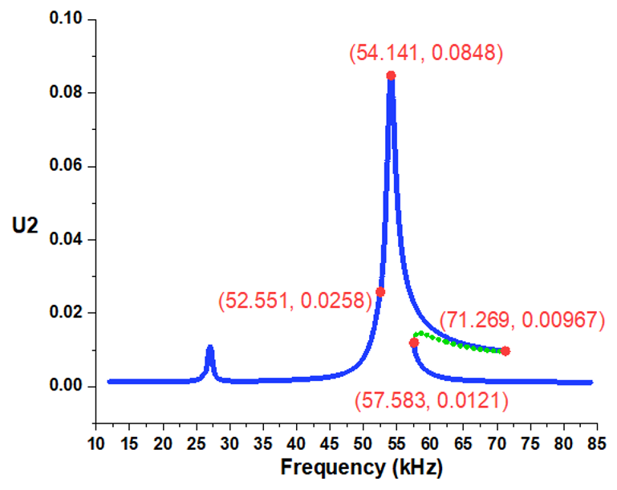
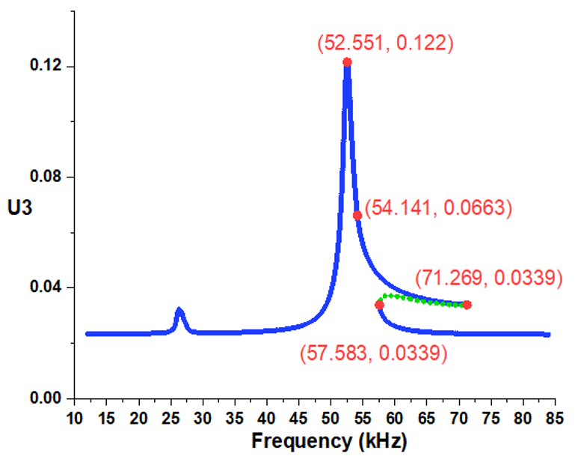
Results and Discussions – Frequency Response
Characteristic points of the frequency response under $V_{DC1}=40V$, $V_{DC2}=10V$, $V_{DC3}=40V$, $V_{AC1}=7.5V$, $V_{AC2}=0V$, and $V_{AC3}=0V.$ (Dotted lines represent unstable branches)
Fold bifurcation jump in U1, peak in U2, peak in U3 are suitable for detecting.
Section 3: Theoretically Results
11
NODYCON 2023, June 18-22, 2023, Rome, Italy
Notes:
To investigate the nonlinear behavior of the system, continuous analyses using the shooting technique were conducted and here we show the selected results. These are frequency response curves of first three global modes, the green dotted lines represent the unstable branches. We could find a fold bifurcation jump in U1 near 71 kilohertz, and a peak in U2 near 54 kilohertz, and a peak in U3 near 52 kilohertz. These three phenomena are suitable for detecting.

Slide 13
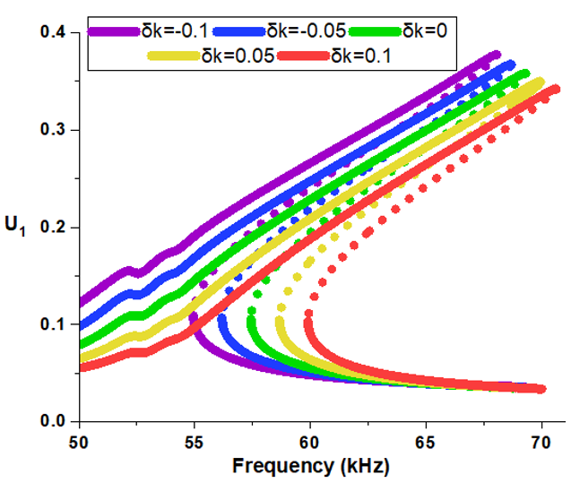
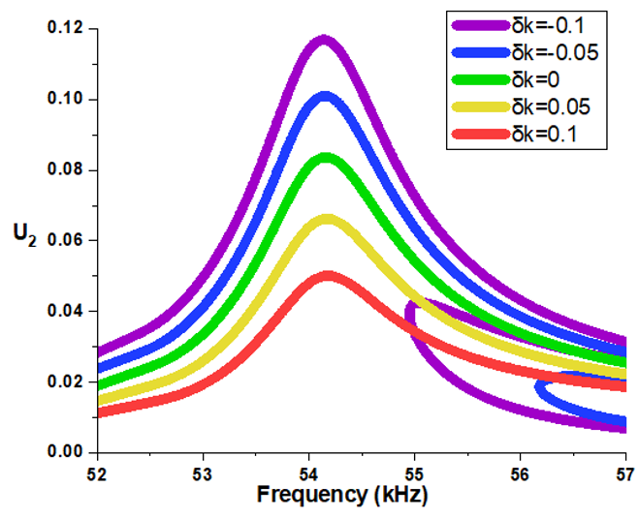
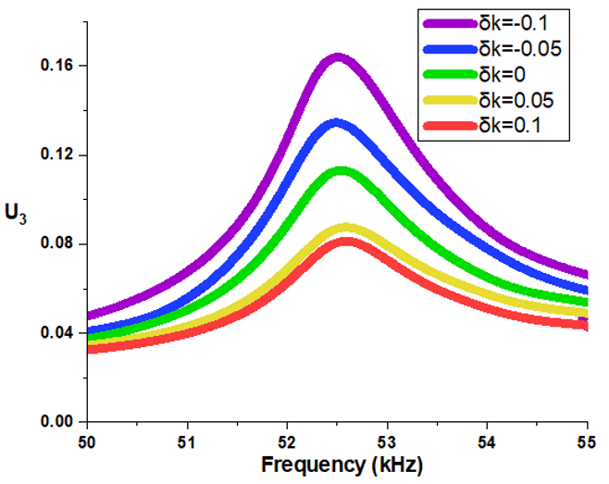
Results and Discussions – Frequency Response
Response dynamics at stiffness perturbation $δk$ on $w_{1}$ with actuation of $V_{AC1}=7V$, $V_{AC2}=0V$, $V_{AC3}=0V$, $V_{DC1}=40V$, $V_{DC2}=10V$and $V_{DC3}=40V$.
The fold jump frequency in U1 is influenced; the peak frequency in U2 and the peak frequency in U3 keeps same.
Section 3: Theoretically Results
12
NODYCON 2023, June 18-22, 2023, Rome, Italy
Notes:
In this slide, We provide the changing value of stiffness perturbation delta k to simulate the convectively heating or cooling on bridge. Different colors curves mean the different value of stiffness from minus 0.1 to plus 0.1. The results show that the fold jump frequency in U1 is influenced due to the stiffness perturbation, however, the peak frequency in U2 and U3 keeps same.

Slide 14
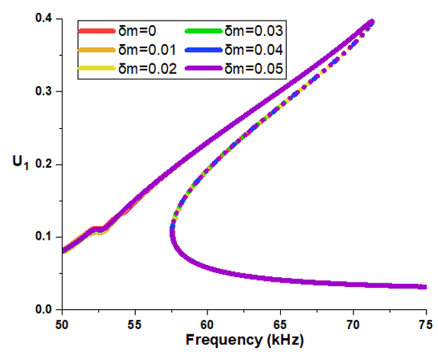
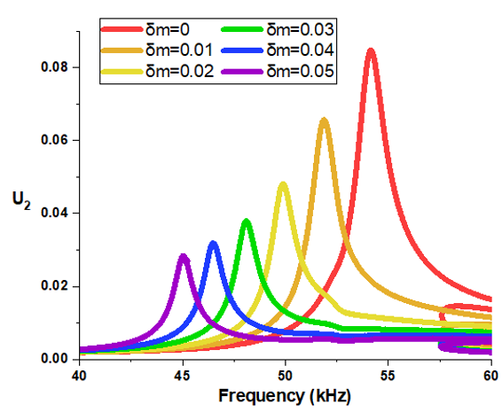
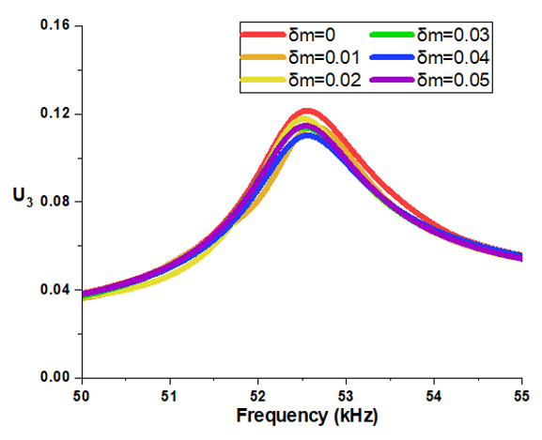
Results and Discussions – Frequency Response
Response dynamics at mass perturbation $δm$ on $w_{2}$ with actuation of $V_{AC1}=7V$, $V_{AC2}=0V$, $V_{AC3}=0V$, $V_{DC1}=40V$, $V_{DC2}=10V$and $V_{DC3}=40V$.
The fold jump frequency in U1 doesn’t change; the peak frequency in U2 varies; and the peak frequency in U3 doesn’t change.
Section 3: Theoretically Results
13
NODYCON 2023, June 18-22, 2023, Rome, Italy
Notes:
Similar simulation is also completed for mass perturbation. In this slide, different colors curves represent the increasing mass perturbation delta m, which simulates the absorption of the coating on cantilever. The results indicate that the nonlinear jump frequency in U1 doesn’t change, while the peak frequency in U2 varies with mass perturbation.

Slide 15
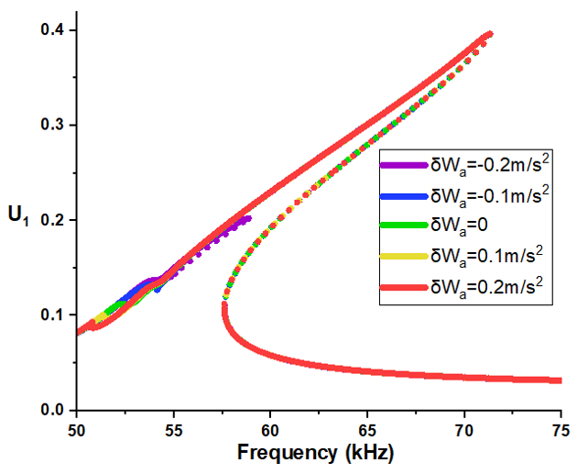
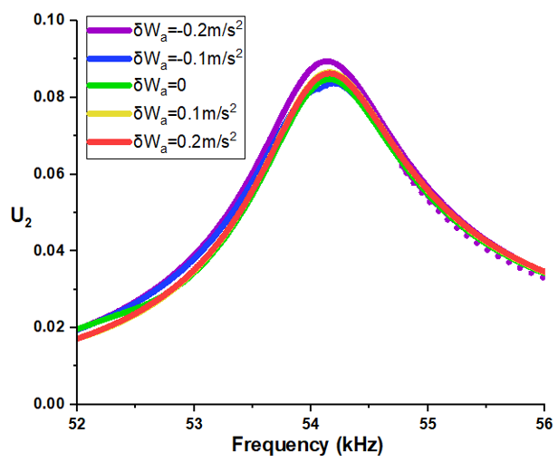
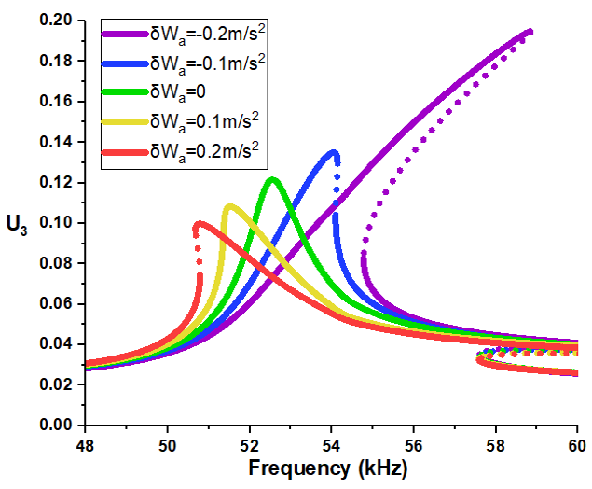
Results and Discussions – Frequency Response
Response dynamics at acceleration perturbation $δW_{a}$ on $w_{3}$ with actuation of $V_{AC1}=7V$, $V_{AC2}=0V$, $V_{AC3}=0V$, $V_{DC1}=40V$, $V_{DC2}=10V$and $V_{DC3}=40V$.
The fold jump frequency in U1 and the peak frequency in U2 keeps same; the nonlinear behaviour with peak frequency in U3 changes.
Section 3: Theoretically Results
14
NODYCON 2023, June 18-22, 2023, Rome, Italy
Notes:
The situation of acceleration perturbation on the sided bridge resonator $W_{3}$ is different, specifically the longitudinal acceleration $W_{a}$ would compress or tense the resonator $W_{3}$ which would change resonator $W_{3}$'s geometric nonlinearity. As right figure shows, the variation of acceleration perturbation from -0.2m/s² to 0.2 m/s² would change the nonlinear behaviour of $U_{3}$ from hardening to softening, which also influences its peak frequency. However, the fold bifurcation jumps in $U_{1}$ and the peak frequency in $U_{2}$ won't change. Combine three kinds of perturbation results, it proves the reliability and feasibility to detect three different perturbations through tracking three modes of vibration. Therefore, realizing the triple-sensing in single structure.

Slide 16
Conclusions
□ Three kinds of perturbations were found to have an independent influence on the first three vibration modes, proving the promising potential of triple sensing on a single device.
□ Setting nonlinear behavior, including bifurcation jumps and peaks, as sensing targets could improve the accuracy and sensitivity of the sensor.
□ Future work will include the practical sensor system design and fabrication;
Instead of the 1st and 2nd modes, actuating the scheme in higher-order modes;
The dynamics of four resonators coupled system and the possibility of quadruple sensing or even more.
Section 4: Conclusions
15
NODYCON 2023, June 18-22, 2023, Rome, Italy
Notes:
Now I would like to conclude our research. Firstly, three kinds of perturbations were found to have an independent influence on the first three vibration modes, proving the promising potential of multi-gas sensing on a single device. Secondly, setting the fold bifurcation and peaks as sensing targets could improve the accuracy and sensitivity of the sensor. At last, future work will include the practical sensor system design and fabrication, specifically, the matched testing circuit and platform. Also, actuating the whole system in higher-order modes is also a potential direction because it may increase the response amplitude and improve the sensitivity. Moreover, the potential of quadruple sensing on four resonators coupled system is attractive.

Slide 17
References
1. Al-Ghamdi, M. S., Khater, M. E., Stewart, K. M. E., Alneamy, A., Abdel-Rahman, E. M., & Penlidis, A. (2019). Dynamic bifurcation MEMS gas sensors. Journal of Micromechanics and Microengineering, 29(1). https://doi.org/10.1088/1361-6439/aaedf9
2. Struk, D., Shirke, A., Mahdavifar, A., Hesketh, P. J., & Stetter, J. R. (2018). Investigating time-resolved response of micro thermal conductivity sensor under various modes of operation. Sensors and Actuators, B: Chemical, 254, 771–777. https://doi.org/10.1016/j.snb.2017.07.142
3. Mustafazade, A., Pandit, M., Zhao, C., Sobreviela, G., Du, Z., Steinmann, P., Zou, X., Howe, R. T., & Seshia, A. A. (2020). A vibrating beam MEMS accelerometer for gravity and seismic measurements. Scientific Reports, 10(1). https://doi.org/10.1038/s41598-020-67046-x
4. Roozeboom, C. L., Hill, B. E., Hong, V. A., Ahn, C. H., Ng, E. J., Yang, Y., Kenny, T. W., Hopcroft, M. A., & Pruitt, B. L. (2015). Multifunctional Integrated Sensors for Multiparameter Monitoring Applications. Journal of Microelectromechanical Systems, 24(4), 810–821. https://doi.org/10.1109/JMEMS.2014.2349894
5. Yaqoob, U., Lenz, W. B., Alcheikh, N., Jaber, N., & Younis, M. I. (2022). Highly selective multiple gases detection using a thermal-conductivity-based MEMS resonator and machine learning. IEEE Sensors Journal, 1–1. https://doi.org/10.1109/JSEN.2022.3203816
References
NODYCON 2023, June 18-22, 2023, Rome, Italy

Slide 18
Q & A
Questions and Answers
NODYCON 2023, June 18-22, 2023, Rome, Italy

