Slide 1
Multi-Gas Sensing Design based on Nonlinear Coupled Micromachined Resonators
Zhengliang Fang, Stephanos Theodossiades and Amal Z. Hajjaj
Wolfson School of Mechanical, Electrical and Manufacturing Engineering, Loughborough, LE11 3TU, UK
E-mail: Z.Fang@lboro.ac.uk
ENOC 2020+2, July 17-22, 2022, Lyon, France
Notes:
Hello everyone, I’m very honor to present our spiring research today. Our research title is Multi-Gas Sensing Design based on Nonlinear Coupled Micromachined Resonators , my name is Zhengliang, I’m from Loughborough University.

Slide 2
Outline
□ Introduction
□ Sensor Modelling
□ Results and Discussions
□ Conclusions
Outline
1
ENOC 2020+2, July 17-22, 2022, Lyon, France
Notes:
Before I start the main content, I would like to give the structure of my presentation. Firstly, I will introduce some background about the MEMS gas sensor and multi-sensing technique, and give our motivation of the project. After that, I will show the sensor structure and methodology with corresponding equations. Then, the simulation results and discussions will be demonstrated. At last, I will conclude the whole research.

Slide 3
Introduction – MEMS Gas Sensor
Micro-Gravimetric Gas Sensor
Al-Ghamdi et al., 2019
Thermal Conductivity Gas Sensor
Struk et al., 2018
Section 1: Introduction
2
ENOC 2020+2, July 17-22, 2022, Lyon, France
Notes:
Recently, the MEMS gas sensor receives remarkable success. Numerous sensor structures had been developed and here are several promising examples from the literature. This is a Micro-Gravimetric Gas Sensor, this kind of gas sensor usually utilizes the coating which could absorb the target gas, this will lead to the mass perturbation on the structure. Hence changing the parameters such as resonance frequency for sensing. Another proven technique could be the thermal conductivity gas sensing technique, this gas sensor is designed to detect the environment temperature variation due to the change of the ambient thermal conductivity.

Slide 4
Introduction – Multimode Sensing Technique
Multimode Gas Sensor
Hajjaj et al., 2020
Section 1: Introduction
3
ENOC 2020+2, July 17-22, 2022, Lyon, France
Notes:
The improvement of accuracy and sensitivity is also a fascinating topic, which raises lots of achievements. Here is one of them, the Multimode Sensing Technique. Simply put, this technique focus on monitoring multi resonant mode shapes to analyze the sensor dynamics. The right figure shows the variation of the first two resonance frequencies f1 and f2 of the bridge resonator versus the threshold voltage, where the author found the best operating point near 2.1 volts.

Slide 5
Introduction – Motivations and Objectives
□ The multi-gas sensing could be achieved through combining two gas sensing techniques, which bring in two types of perturbations simultaneously.
□ The multimode sensing technique owes the potential to detect two different kinds of perturbations through monitoring two resonance frequencies.
Section 1: Introduction
4
ENOC 2020+2, July 17-22, 2022, Lyon, France
Notes:
During our research, we raised a solution for the multi-gas sensing. If we could combine two different gas sensing techniques into one single structure, this structure would have the ability to detect multi type gases. It will introduce different perturbations into the structure, and exactly the multimode sensing technique could detect them through monitoring two resonance frequencies.

Slide 6
Introduction – Novelty
□ The coupled beam is a common structure in literature for its linear behavior, this research aims on utilizing nonlinear behavior.
□ Achieving the multi-sensing in single device could provide large benefits: reduce the cost, simplify the structure, ease to integrate.
Section 4: Conclusions
5
ENOC 2020+2, July 17-22, 2022, Lyon, France
Notes:
So, what’s the difference between our work and others? Firstly, the coupled microbeam, including the coupled cantilever, coupled bridge and their combinations, is a frequently used structure in sensor design, many researchers utilized its linear behavior, especially mode localization, to design their sensor structure. However, our research will detect some nonlinear behavior to obtain further sensitivity. In addition, achieving the multi-sensing in single device owes obvious benefits: such as reducing the cost, simplifying the system structure and make it easier to embed with other components.

Slide 7
Sensor Modelling – Sensor Structure
Section 2: Sensor Modelling
6
ENOC 2020+2, July 17-22, 2022, Lyon, France
Notes:
This is the main structure of our sensor. This sensor comprises a weakly coupled-resonator, including a cantilever and bridge resonator with a thin coupling beam weakly couples them. Both cantilever and the bridge resonators are driven electrostatically by a DC polarization actuating V_{DC}. And the AC harmonic actuation V_{AC} is given on one of them depends on the actuation theory.

Slide 8
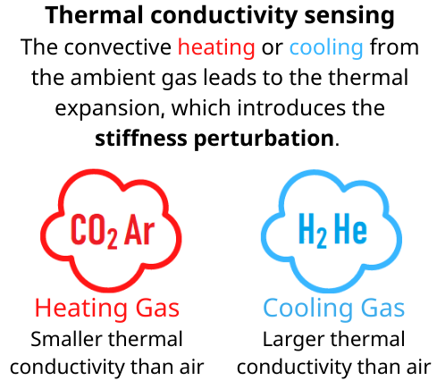
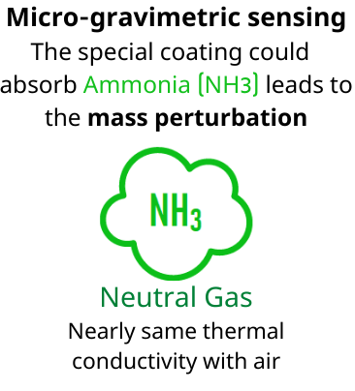
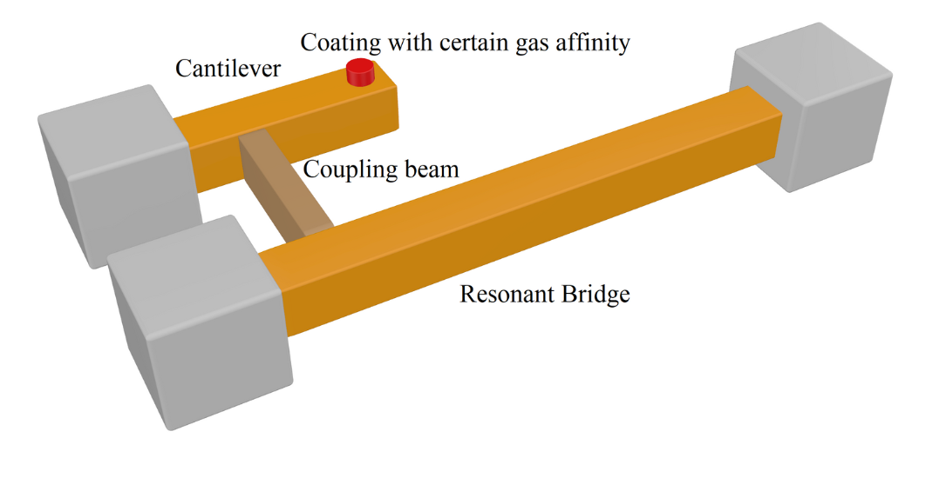
Sensor Modelling – Sensor Methodology
Section 2: Sensor Modelling
7
ENOC 2020+2, July 17-22, 2022, Lyon, France
Notes:
As I mentioned before, the main concept of this project is the combination of two sensing techniques. The first theory is the micro-gravimetric sensing performing on cantilever. The special coating which could absorb the Ammonia will be set on the tip of cantilever, hence leading to the mass perturbation. An important point should be mentioned is the ammonia has nearly same thermal conductivity with air, where the sensor will be operated, therefore has no conflict to another technique, the thermal conductivity sensing. The bridge resonator will be heating or cooling due to the change of ambient thermal conductivity, this would lead to the thermal expansion, hence introducing the stiffness perturbation to bridge. Now two different sensing techniques are perfect combined in this structure, bring the mass and stiffness perturbations respectively.

Slide 9
Sensor Modelling – Sensor Equations
Euler-Bernoulli Equations:
$$EI{\tilde{w}}_{1}^{′′′′}+ρA\ddot{{\tilde{w}}_{1}}+[\tilde{N}−\frac{Ebh}{2L_{2}}\int_{0}^{L_{1}}{{({\tilde{w}}_{1}^{′})}^{2}dx}]{\tilde{w}}_{1}^{′′}+{\tilde{c}}_{1}\dot{{\tilde{w}}_{1}}−{\tilde{k}}_{r}\left({\tilde{w}}_{1}^{′}\left(X_{c}\right)−{\tilde{w}}_{2}^{′}\left(X_{c}\right)\right)δ^{′}\left(\tilde{x}−{\tilde{X}}_{c}\right) =\frac{1}{2}ε_{0}\frac{b{\left[V_{DC1}+V_{AC1}∗\cos\left({\tilde{Ω}}_{1}\tilde{t}\right)\right]}^{2}}{{\left(d_{1}−{\tilde{w}}_{1}\right)}^{2}}$$
$$EI{\tilde{w}}_{2}^{′′′′}+\left(ρA+\tilde{m}δ\left(\tilde{x}−{\tilde{X}}_{m}\right)\right)\ddot{{\tilde{w}}_{2}}+{\tilde{c}}_{2}\dot{{\tilde{w}}_{2}}−k_{r}\left({\tilde{w}}_{2}^{′}\left(X_{c}\right)−{\tilde{w}}_{1}^{′}\left(X_{c}\right)\right)δ^{′}\left(\tilde{x}−{\tilde{X}}_{c}\right)=\frac{1}{2}ε_{0}\frac{b{\left[V_{DC2}+V_{AC2}∗\cos\left({\tilde{Ω}}_{2}\tilde{t}\right)\right]}^{2}}{{\left(d_{2}−{\tilde{w}}_{2}\right)}^{2}}$$
${\tilde{w}}_{1}$ (for bridge resonator) and ${\tilde{w}}_{2}$ (for cantilever resonator)
Section 2: Sensor Modelling
8
ENOC 2020+2, July 17-22, 2022, Lyon, France
Notes:
These Euler-Bernoulli equations represent the system motions. The W1 and W2 are transverse deflections for bridge and cantilever respectively. The detailed derivation process is omitted here, if you are interested with them, you could contact us with e-mail later.

Slide 10
Sensor Modelling – Sensor Equations
After nondimensionalising and discretising using Galerkin procedure:
$$\left(\frac{∂^{2}u_{1}}{∂t^{2}}+c_{1n}\frac{∂u_{1}}{∂t}+\int_{0}^{1}{φ_{1}φ_{1}^{′′′′}dx}u_{1}(1+δk)−k_{r}[u_{1}{\left(φ_{1}^{′}\left(X_{c}\right)\right)}^{2}−u_{2}φ_{1}^{′}\left(X_{c}\right)φ_{2}^{′}\left(X_{c}\right)]\right)∗\left(1−2u_{1}\int_{0}^{1}{φ_{1}^{3}dx}+u_{1}^{2}\int_{0}^{1}{φ_{1}^{4}dx}\right)−α_{1}\int_{0}^{1}{{φ_{1}^{′}}^{2}dx}\left(u_{1}^{3}\int_{0}^{1}{φ_{1}^{′′}φ_{1}dx}−2u_{1}^{4}\int_{0}^{1}{φ_{1}^{′′}φ_{1}^{2}dx}+u_{1}^{5}\int_{0}^{1}{φ_{1}^{′′}φ_{1}^{3}dx}\right)=α_{2}{\left[V_{DC1}+V_{AC1}\cos\left(Ω_{2}t\right)\right]}^{2}\int_{0}^{1}{φ_{1}dx}\left(1\right)$$
$$\left(\frac{∂^{2}u_{2}}{∂t^{2}}(1+δm\left(x−X_{m}\right))+c_{2n}\frac{∂u_{2}}{∂t}+\int_{0}^{R_{L}}{φ_{2}φ_{2}^{′′′′}dx}u_{2}−k_{r}[u_{2}{\left(φ_{2}^{′}\left(X_{c}\right)\right)}^{2}−u_{1}φ_{1}^{′}\left(X_{c}\right)φ_{2}^{′}\left(X_{c}\right)]\right)∗\left(R_{d}^{2}−2R_{d}u_{2}\int_{0}^{R_{L}}{φ_{2}^{3}dx}+u_{2}^{2}\int_{0}^{R_{L}}{φ_{2}^{4}dx}\right)=α_{2}{\left[V_{DC2}+V_{AC2}\cos\left(Ω_{2}t\right)\right]}^{2}\int_{0}^{R_{L}}{φ_{2}dx}(2)$$
Equation 1: Bridge resonator with stiffness perturbation $δk$
Equation 2: Cantilever resonator with mass perturbation $δm$
Section 2: Sensor Modelling
9
ENOC 2020+2, July 17-22, 2022, Lyon, France
Notes:
After nondimensionalising and discretising using Galerkin procedure, the governing non-dimensional equations are written as shown. The equation 1 on above represents the motion of bridge with stiffness perturbation delta k, while the below equation shows the motion of cantilever with mass perturbation delta m. The following simulation is based on these two equations.

Slide 11
Results and Discussions – Frequency Response
(61.685, 0.407)
(48.142, 0.180)
(48.142, 0.160)
(61.685, 0.0164)
Frequency response: (Left) U1 and (Right) U2 with actuation of $V_{DC1}=40V$, $V_{DC2}=10V$, $V_{AC1}=7.5V$and $V_{AC2}=0V$. (Dotted lines represent unstable branches)
Nonlinear bifurcation jump in U1 and peak in U2 are suitable for detecting.
Section 3: Theoretically Results
10
ENOC 2020+2, July 17-22, 2022, Lyon, France
Notes:
To investigate the nonlinear behavior of the system, continuous analyses using the shooting technique were conducted and here we show the selected results. These are frequency response curves of first two global modes, the green dotted lines represent the unstable branches. We could find that a nonlinear bifurcation jump appears in U1 near 61 kilohertz, and a peak appear in U2 near 48 kilohertz. These two phenomena are suitable for detecting.

Slide 12
Results and Discussions – Sensing Scheme
Response dynamics at stiffness perturbation $δk$ on bridge with actuation of $V_{DC1}=40V$, $V_{DC2}=10V$, $V_{AC1}=7.5V$and $V_{AC2}=0V$: (Left) U1 and (Right) U2. (Dotted lines represent unstable branches)
The nonlinear jump frequency in U1 is influenced;
the peak frequency in U2 keeps same.
Section 3: Theoretically Results
11
ENOC 2020+2, July 17-22, 2022, Lyon, France
Notes:
In this slide, We provide the changing value of stiffness perturbation delta k to simulate the convectively heating or cooling on bridge. Different colors curves mean the different value of stiffness from minus 0.1 to plus 0.1. The results show that the nonlinear jump frequency in U1 is influenced due to the stiffness perturbation, however, the peak frequency in U2 keeps same.

Slide 13
Results and Discussions – Sensing Scheme
Response dynamics at mass perturbation $δm$ on cantilever with actuation of $V_{DC1}=40V$, $V_{DC2}=10V$, $V_{AC1}=7.5V$and $V_{AC2}=0V$: (Left) U1 and (Right) U2. (Dotted lines represent unstable branches)
The nonlinear jump frequency in U1 doesn’t change;
the peak frequency in U2 varies.
Section 3: Theoretically Results
12
ENOC 2020+2, July 17-22, 2022, Lyon, France
Notes:
Similar simulation is also completed for mass perturbation. In this slide, different colors curves represent the increasing mass perturbation delta m, which simulates the Ammonia absorption of the coating on cantilever. The results indicate that the nonlinear jump frequency in U1 doesn’t change, while the peak frequency in U2 varies with mass perturbation. This results are exactly opposite to the results in stiffness perturbation simulation. Hence, it is possible to detect two different perturbations through tracking two modes of vibration of the two beams. Therefore, realizing the multi-sensing in single structure.

Slide 14
Conclusions
□ Stiffness and mass perturbations of the bridge and cantilever resonators, respectively, were found to have an independent influence on the two vibration modes, proving the promising potential of multi-gas sensing on a single device.
□ Setting nonlinear behavior, including bifurcation jumps and peaks, as sensing targets could improve the accuracy and sensitivity of the sensor.
□ Future work will include the practical sensor system design and fabrication;
Instead of the 1st and 2nd modes, actuating the scheme in higher-order modes.
Section 4: Conclusions
13
ENOC 2020+2, July 17-22, 2022, Lyon, France
Notes:
Now I would like to conclude our research. Firstly, Stiffness and mass perturbations of the bridge and cantilever resonators, respectively, were found to have an independent influence on the two vibration modes, proving the promising potential of multi-gas sensing on a single device. Secondly, setting the Nonlinear behavior, including bifurcation jumps and peaks, as sensing targets could improve the accuracy and sensitivity of the sensor. At last, future work will include the practical sensor system design and fabrication, specifically, the matched testing circuit and platform. Also, actuating the whole system in higher-order modes is also a potential direction because it may increase the response amplitude and improve the sensitivity

Slide 15
References
1. Al-Ghamdi, M. S., Khater, M. E., Stewart, K. M. E., Alneamy, A., Abdel-Rahman, E. M., & Penlidis, A. (2019). Dynamic bifurcation MEMS gas sensors. Journal of Micromechanics and Microengineering, 29(1). https://doi.org/10.1088/1361-6439/aaedf9
2. Struk, D., Shirke, A., Mahdavifar, A., Hesketh, P. J., & Stetter, J. R. (2018). Investigating time-resolved response of micro thermal conductivity sensor under various modes of operation. Sensors and Actuators, B: Chemical, 254, 771–777. https://doi.org/10.1016/j.snb.2017.07.142
3. Hajjaj, A. Z., Jaber, N., Alcheikh, N., & Younis, M. I. (2020). A Resonant Gas Sensor Based on Multimode Excitation of a Buckled Microbeam. IEEE Sensors Journal, 20(4), 1778–1785. https://doi.org/10.1109/JSEN.2019.2950495
References
ENOC 2020+2, July 17-22, 2022, Lyon, France

Slide 16
Q & A
Questions and Answers
ENOC 2020+2, July 17-22, 2022, Lyon, France
Notes:
Fringe field effect: we neglect it now as it is the first stage of the whole research. In our expectation, it may has slightly effect in some parameters such as the amplitude of frequency response. But it won’t influence the nonlinear dynamics a lot, which is our research priority. In the future research, we will include the fringe field effect in our modelling, but not at present.
Slightly fluctuation: it is due to the order 2 super-harmonic behavior; you could find the frequency of this fluctuation is just half of the resonance frequency and it has similar shape with the main peak. It is due to the nonlinearity in this structure comes from the electrostatic actuating, which is a quadratic nonlinear term. Generally, the quadratic nonlinearity generate the order 2 super-harmonic behavior with half frequency while the cubic nonlinearity generate the order 3 super-harmonic behavior with one third frequency, this relationship is decided by the mode shape of the micro beam that contains trigonometric terms, the detailed description could be found in the literature, we could talk it later if you have interests.
Mode shapes: we use the first and second local mode shapes of cantilever and bridge resonator in our research.

