Slide 1
Gas Sensor Based on Nonlinear Coupled AlN-Piezoelectric Micromachined Resonators
Zhengliang Fang¹, Stephanos Theodossiades¹, Nizar Jaber² and Amal Z. Hajjaj¹*
1Wolfson School of Mechanical, Electrical and Manufacturing Engineering, Loughborough University, UK
2Department of Mechanical Engineering, King Fahd University of Petroleum and Minerals, Dhahran, Saudi Arabia.
*a.a.hajjaj@lboro.ac.uk

Slide 2
Outline
□ Introduction
□ Sensor Modelling
□ Experiment Setup and Results
□ Conclusions
Outline
1
Notes:
Before I start the main content, I would like to give the structure of my presentation. Firstly, I will introduce some background about the MEMS technique and how they are using in Electric Vehicles, and give our motivation of the project. After that, I will show the sensor structure and methodology. Then, I will show the experiment setup and some preliminary results. At last, I will conclude the whole research.

Slide 3
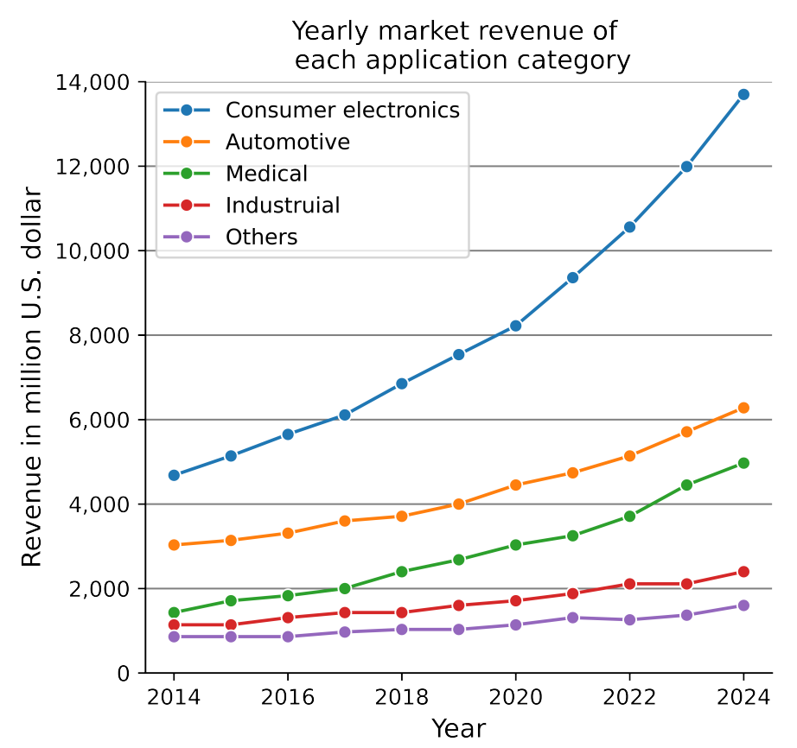
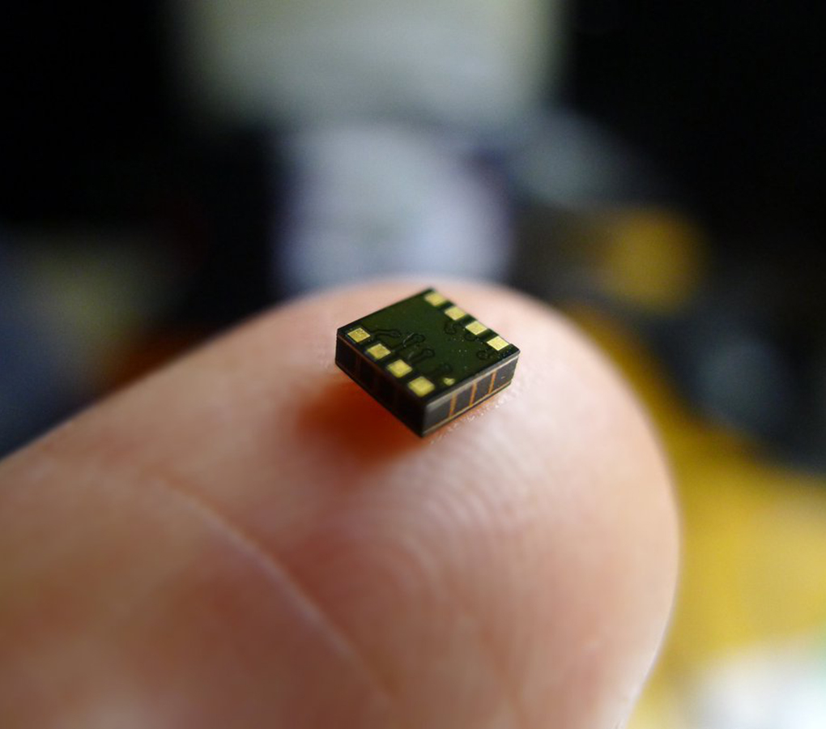
Introduction – MEMS Sensor
Micro-
Electro-
Mechanical-
System
High-Performance Ultrasonic MEMS Sensor
(AudioXpress, 2022)
MEMS market revenues by application from 2014 to 2024
(Itilekha et al., 2023)
Section 1: Introduction
2
Notes:
Recently, a new technique named Micro-Electro-Mechanical-System (MEMS) techniques is proven to give high performance in sensing applications. This kind of sensors are quite small with high sensitivity, low power consumption, and long-term stability. Hence, the demand for MEMS sensors is ever-increasing in last 10 years and will keep rising in future.

Slide 4
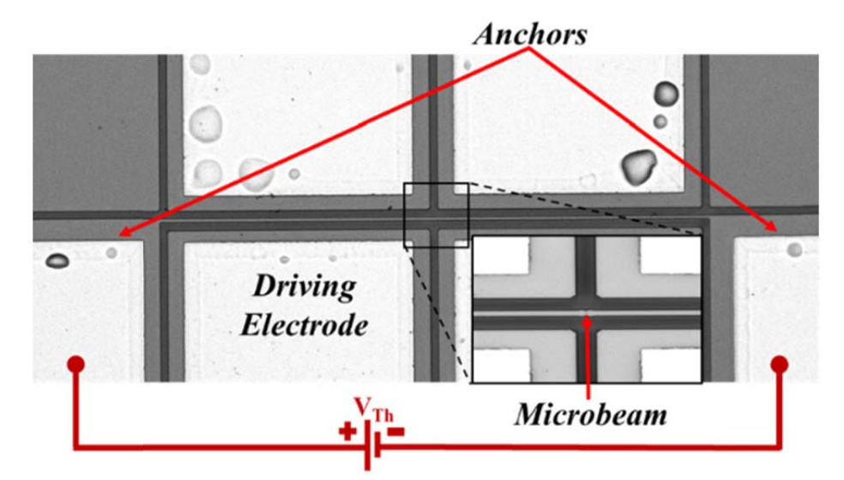
Introduction – MEMS Gas Sensor
Micro-Gravimetric Gas Sensor
Al-Ghamdi et al., 2019
Thermal Conductivity Gas Sensor
Amal et al., 2018
Section 1: Introduction
3
Notes:
Among many types of MEMS sensor, the MEMS gas sensor receives remarkable success. Numerous sensor structures had been developed and here are several promising examples from the literature. This is a Micro-Gravimetric Gas Sensor, this kind of gas sensor usually utilizes the coating which could absorb the target gas, this will lead to the mass perturbation on the structure. Hence changing the parameters such as resonance frequency for sensing. Another proven technique could be the thermal conductivity gas sensing technique, this gas sensor is designed to detect the environment temperature variation due to the change of the ambient thermal conductivity.

Slide 5
Introduction – Motivations and Objectives
□ We proposes a new MEMS gas sensing structure using the dynamic response of an AlN-piezoelectric-based weakly coupled resonator, related to the environmental monitoring and IoT applications.
Section 1: Introduction
4
Notes:
During our research, we proposes a new MEMS gas sensing structure using the dynamic response of an AlN-piezoelectric-based weakly coupled resonator. Such a gas sensor will be a perfect solution for the environmental monitoring and other IoT applications.

Slide 6
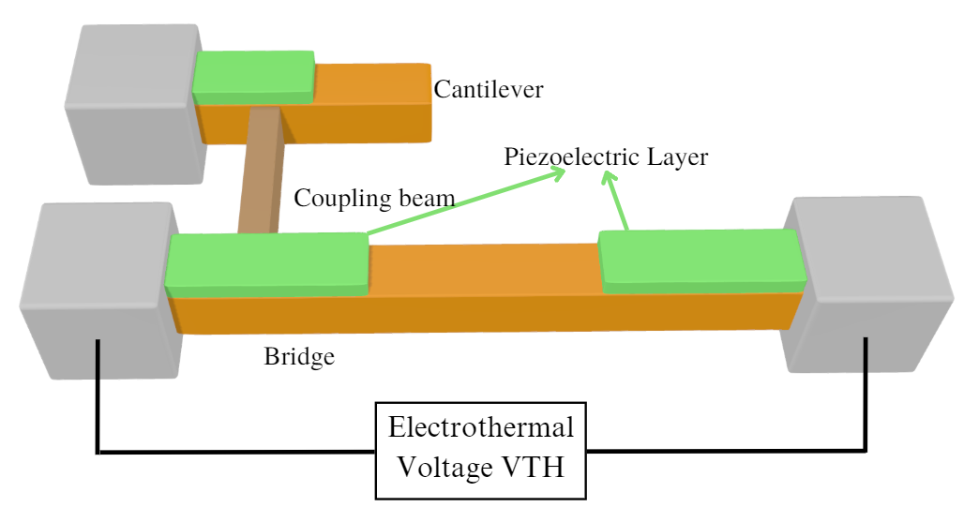
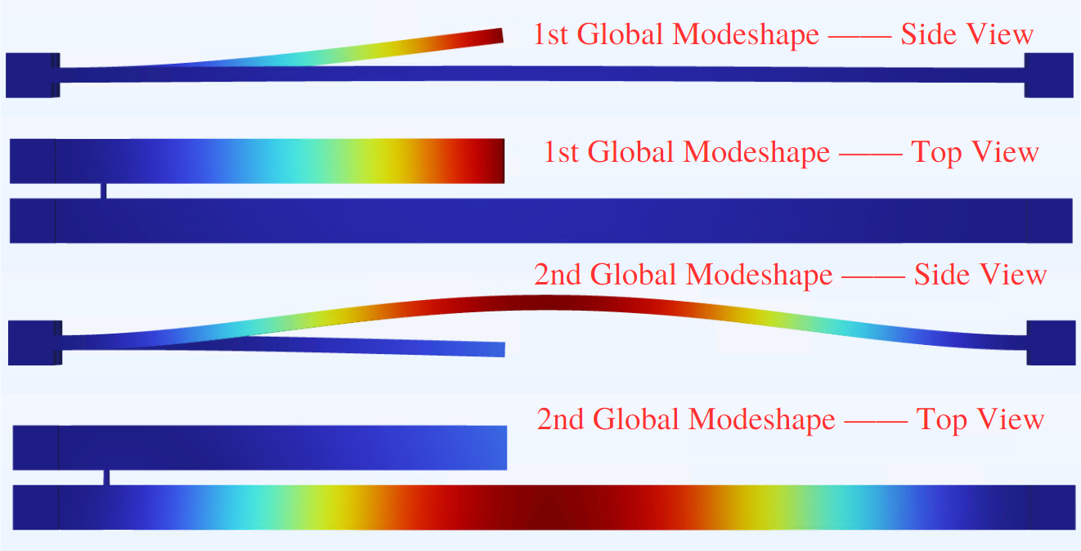
Sensor Modelling – Structure & Methodology
AlN piezoelectric actuation
The AlN piezoelectric layer coated on the bridge would experience periodic deformation under external AC actuation, therefore generate the vibration of the system.
Thermal Conductivity Sensing
The convective cooling from the ambient gas (He/H₂) leads to the thermal expansion, which introduces the stiffness perturbation to bridge resonator.
Section 2: Sensor Modelling
5
Notes:
This in the main structure of my sensor. This gas sensor comprises a cantilever and a bridge resonator represents as orange bars. A thin coupling beam, which is brown bar, weakly couples both resonators. The external AC actuation will be provided on the AlN piezoelectric layer and lead to the periodic deformation, therefore generate the vibration of whole system. An electrothermal voltage Vth is provided to heat the bridge resonator and tune the resonance frequency. The thermal conductivity sensing technique is used here, which means that if the heated bridge contacts the high thermal conductivity gas like Helium, the bridge will be cooled down due to convection and the stiffness will be changed and influence the resonance frequency. The under graph shows the first two global modeshapes discussed in the experiment.

Slide 7
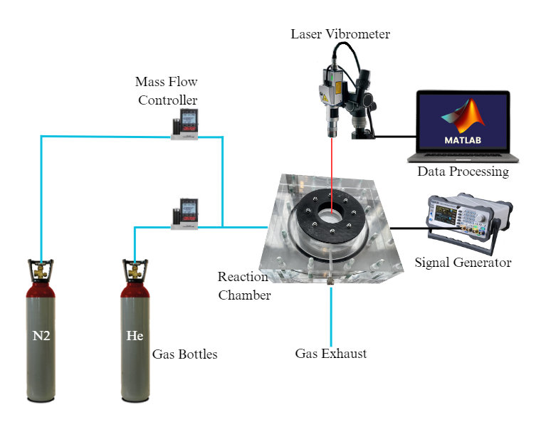
Experiment – Setup
Section 3: Experiments
6
Notes:
Here are our experiment setup. The MEMS device is placed in the reaction chamber, which is equipped with ports connected to the signal generator, at atmospheric pressure and room temperature. Three gas bottles, which contain Nitrogen and Helium, respectively, provide the gas input in the experiment. Here the Nitrogen is the carrier gas while Helium is the target gas in this experiment. The mass flow controllers which directly connected to the gas bottles are used to control the flow values of the two gases hence adjusting the gas concentration in the chamber. A laser vibrometer is adopted to monitor the motion of the sensor and we used Matlab to process the raw data from vibrometer. The right figure shows the SEM photo of the multi-sensor.

Slide 8
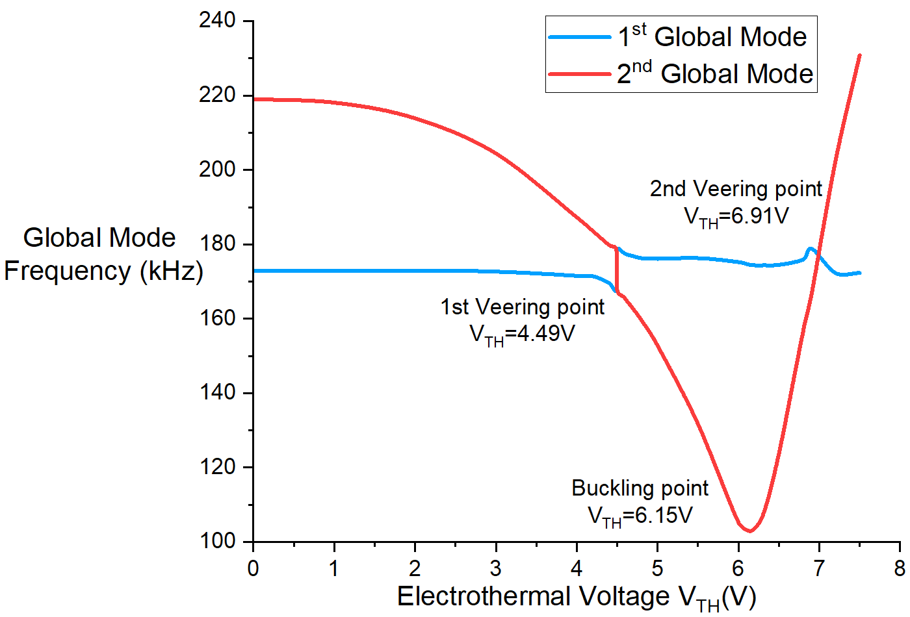
Experiment – Frequency Response
External DC voltage Vth is used to tune the resonance frequencies.
1st Global Mode: Keeps same
2nd Global Mode:
$\left\{\begin{aligned}Decrease (V_{TH}<6.15V) \\ Increase (V_{TH}>6.15V)\end{aligned}\right.$
Buckling Point: $V_{TH}=6.15V$
Veering Point:
$V_{TH}=4.49V$/ $V_{TH}=6.91V$
Section 3: Experiments
7
Notes:
As we introduced before, the external DC voltage is used to tune the resonance frequency. In the frequency response, the 1st and 2nd global modes are highlighted in red and blue colour bars, respectively. From the graph, we could find that the 1st global mode keeps same while 2nd global mode experiences the frequency shift. Before the buckling point at Vth=6.15V, the 1st global modes resonance frequency is decreased. After buckling point, the 1st global mode resonance frequency is increased due to the deformation of the resonant bridge. The veering point is found at Vth=4.49V and 6.91V where two global modes exchanges the characteristic.
bridge resonator is dominated by the quadratic nonlinearity linked to curvature and shift to left with increasing Vth
bridge resonator is buckled, and the dominated nonlinearity is the cubic nonlinearity from midplane stretching hence the resonance frequency shift to right

Slide 9
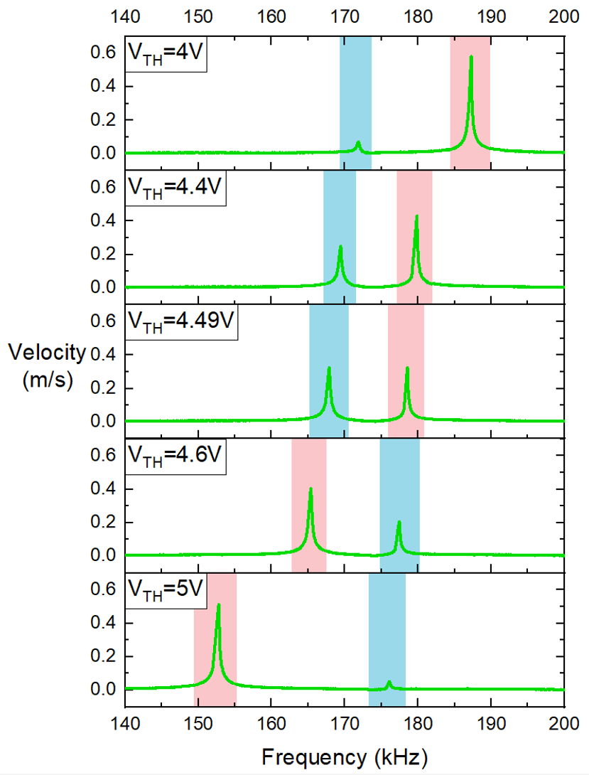
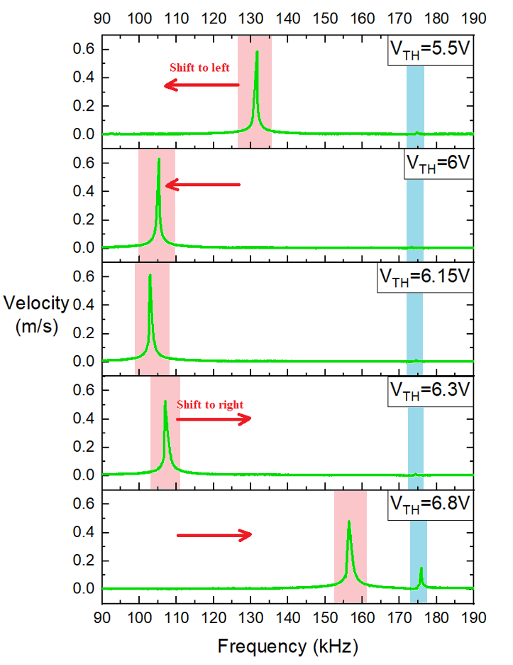
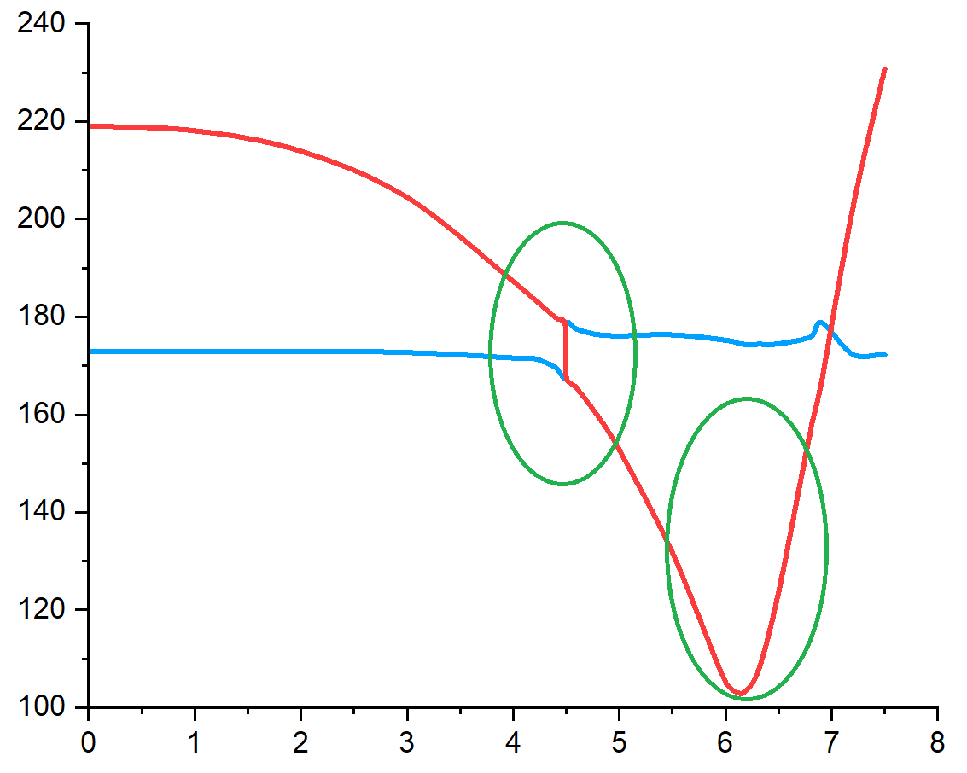
Experiment – Veering Point & Buckling Point
Veering Point: $V_{TH}=4.49V$
Buckling Point: $V_{TH}=6.15V$
Section 3: Experiments
8
Notes:
In the frequency response, the 1st and 2nd global modes are highlighted in red and blue colour bars, respectively. From the graph, we could find that the 1st global mode keeps same while 2nd global mode experiences the frequency shift. When VTH is smaller than 6.15V, the bridge resonator is dominated by the quadratic nonlinearity linked to curvature and shift to left with increasing Vth. After 6.15V, the bridge resonator is buckled, and the dominated nonlinearity is the cubic nonlinearity from midplane stretching hence the resonance frequency shift to right. An interesting phenomenon is that at veering point between V_{TH}=4.49V and V_{TH}=4.6V, the resonance frequencies of two global modes are exchanged.

Slide 10
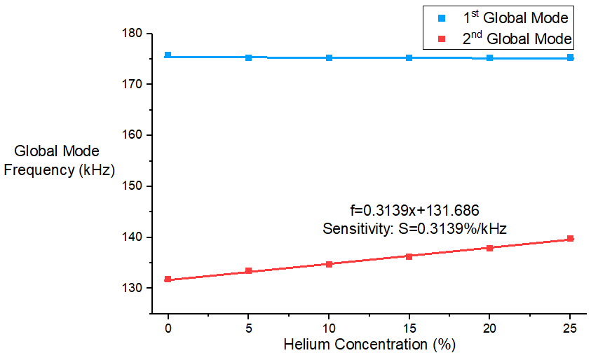
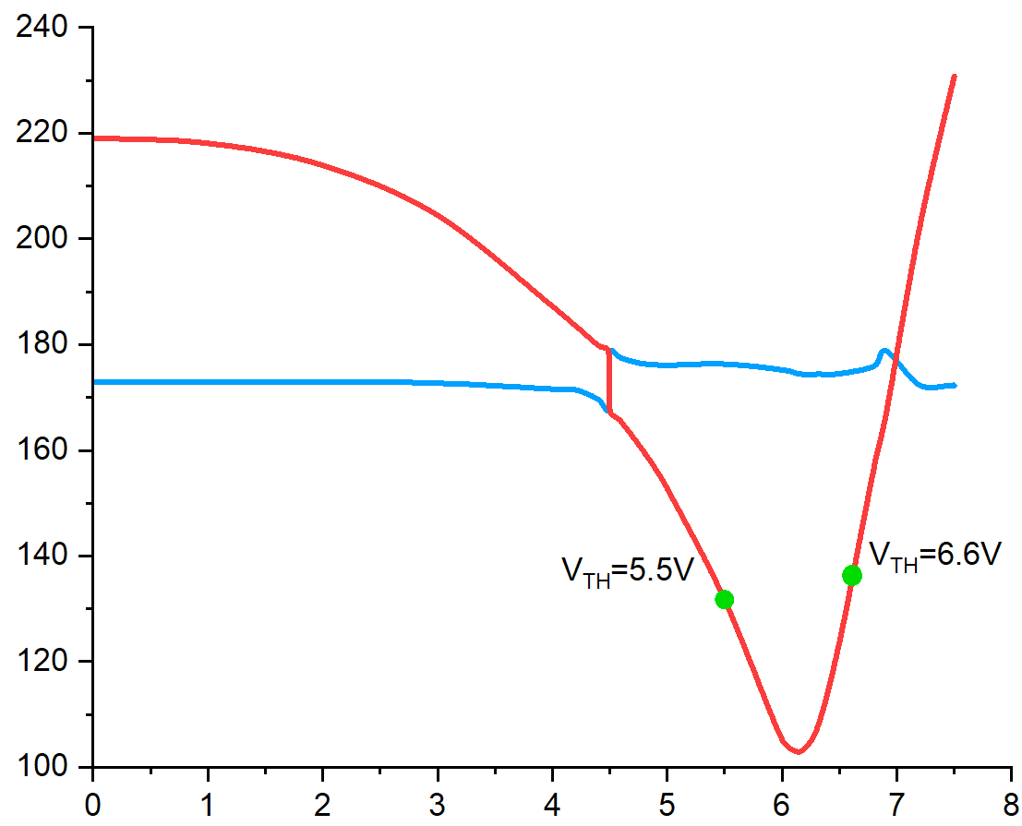
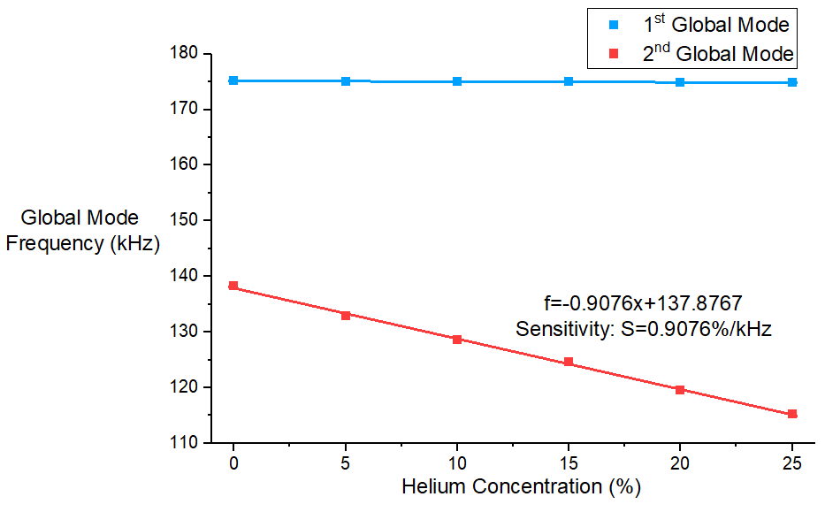
Experiment – Helium Experiment Result
1st Global Mode: Keeps same
2nd Global Mode: Vary
Above: $V_{TH}=5.5V$.
Sensitivity: 0.3139%/kHz.
Below: $V_{TH}=6.6V$.
Sensitivity: 0.9076%/kHz.
Section 3: Experiments
9
Notes:
Here are the experiment result for our sensor. In the experiment, we inset the increasing concentration of Helium gases which will cool down the bridge resonator, hence counteract the influence of electrothermal heating. From the experiment result, we can find that the 1st mode’s resonance frequency keeps same while the 2nd mode’s resonance frequency is influenced. We choose two different operation points, one before the buckling point and one after. The above graph shows the Helium sensing at VTH=5.5V before buckling point, which gives high linear results with sensitivity of 0.3139%/kHz. While the below one shows the result of $V_{TH}=6.6V$ after buckling point. The helium sensing curves is also highly linear with higher sensitivity of 0.9076 percent per kHz, shows its great potential.

Slide 11
Conclusions
□ A new gas sensing structure using the dynamic response of an AlN-piezoelectric-based weakly coupled resonator is proposed both in theoretical analysis and experiment. The experiment result fits the theoretical simulations perfectly.
□ The Helium sensing experiment shows highly linear and sensitivity results.
□ The future work will focus on multi-gas sensing on single coupled structure through introducing another sensing technique (i.e. coating technique) on cantilever.
Section 4: Conclusions
10
Notes:
Now I would like to conclude our research. Firstly, we proposed a new gas sensing structure using the dynamic response of an AlN-piezoelectric-based weakly coupled resonator is proposed both in theoretical analysis and experiment. The experiment result fits the theoretical simulations perfectly. Then, the Helium sensing experiment shows highly linear and sensitivity results. In the future, we will focus on multi-gas sensing on single coupled structure through introducing another sensing technique (i.e. coating technique) on cantilever.

Slide 12
References
1. AudioXpress. (2022). TDK Acquires Ultrasonic MEMS Sensing Solutions Developer Chirp Microsystems. Available at: https://audioxpress.com/news/tdk-acquires-ultrasonic-mems-sensing-solutions-developer-chirp-microsystems (Accessed: 16 August 2023).
2. Podder, I., Fischl, T., & Bub, U. (2023). Artificial Intelligence Applications for MEMS-Based Sensors and Manufacturing Process Optimization. Telecom, 4(1), 165–197. https://doi.org/10.3390/telecom4010011 .
3. Al-Ghamdi, M. S., Khater, M. E., Stewart, K. M. E., Alneamy, A., Abdel-Rahman, E. M., & Penlidis, A. (2019). Dynamic bifurcation MEMS gas sensors. Journal of Micromechanics and Microengineering, 29(1). https://doi.org/10.1088/1361-6439/aaedf9
4. A. Z. Hajjaj, N. Jaber, N. Alcheikh and M. I. Younis. (2020). A Resonant Gas Sensor Based on Multimode Excitation of a Buckled Microbeam. IEEE Sensors Journal, vol. 20, no. 4, pp. 1778-1785. doi: 10.1109/JSEN.2019.2950495.
5. Z. Fang, S. Theodossiades, L. Ruzziconi, and A. Z. Hajjaj. (2023). A multi-sensing scheme based on nonlinear coupled micromachined resonators. Nonlinear Dyn, vol. 111, no. 9, pp. 8021–8038. doi: 10.1007/s11071-023-08294-0 .
References
ENOC 2020+2, July 17-22, 2022, Lyon, France

