Slide 1
DYNAMICS OF A PIEZOELECTRIC MEMS GAS SENSOR BASED ON COUPLED MICROMACHINED RESONATORS
Zhengliang Fang¹, Stephanos Theodossiades¹, Fasil Dejene² and Amal Z. Hajjaj¹
¹Wolfson School of Mechanical, Electrical and Manufacturing Engineering, Loughborough, LE11 3TU, UK
²Department of Physics, Loughborough University, UK
E-mail: Z.Fang@lboro.ac.uk, a.a.hajjaj@lboro.ac.uk
Notes:
Hello everyone, I’m very honor to present our spiring research today. Our research title is DYNAMICS OF A PIEZOELECTRIC MEMS GAS SENSOR BASED ON COUPLED MICROMACHINED RESONATORS, my name is Zhengliang, I’m from Loughborough University.

Slide 2
Outline
□ Introduction
□ Sensor Modelling
□ Results and Discussions
□ Conclusions
Outline
1
PowerMEMS, December 11-14, 2023, Abu Dhabi, UAE
Notes:
Before I start the main content, I would like to give the structure of my presentation. Firstly, I will introduce some background about the MEMS gas sensor and multi-sensing technique, and give our motivation of the project. After that, I will show the sensor structure and methodology with corresponding equations. Then, the simulation results and discussions will be demonstrated. At last, I will conclude the whole research.

Slide 3
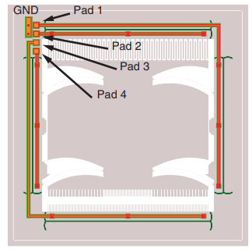
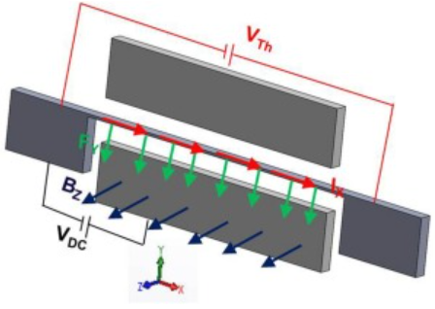
Introduction – Buckling Phenomenon
MEMS Gas Sensor Based
on Buckling Phenomenon
Hajjaj et al., 2020
MEMS Magnetic Sensor Based
on Buckling Phenomenon
Alcheikh et al., 2021
MEMS Inertial Sensor Based
on Buckling Phenomenon
EI Mansouri et al., 2019
The resonance frequency tunning is required to operate near or at buckling point
Electrothermal
Electrostatic
Electromagnetic
Section 1: Introduction
2
PowerMEMS, December 11-14, 2023, Abu Dhabi, UAE
Notes:
Recently, the MEMS sensor based on buckling phenomenon has been investigated extensively in the past few years. The corresponding sensors generally actuate the resonators near buckling point therefore generate a bistable mechanism and lead large variations on system dynamics. The MEMS sensor based on such technology had been utilized on sensing gases, magnetic, flow value and other applications. However, there are still some challenges in energy consumption in resonance frequency tuning issue. Generally, an external source is introduced to tune the resonance frequency near or at buckling point based on electrostatic, electrothermal, and electromagnetic theory. Which leads extensively power consumption comparing and even becomes main energy consumption element in some sensor designs.

Slide 4
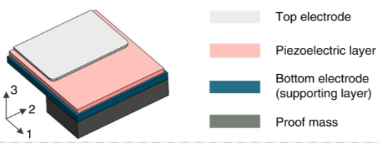
Introduction – TPoS MEMS
Thin-film
Piezoelectric
On
Silicon
MEMS piezoelectric Accelerometer
Gong et al., 2023
Section 1: Introduction
3
PowerMEMS, December 11-14, 2023, Abu Dhabi, UAE
Notes:
On the other hand, the MEMS sensor based on TPoS structure receives remarkable success and is suitable to combined with buckling phenomenon. Such kinds of sensor comprise a silicon resonator with a thin piezoelectric layer deposited on the top. The TPoS MEMS resonator is actuated by a harmonic voltage signal on the piezoelectric layer and lead to the periodic deformation, therefore generate the vibration due to the reverse piezoelectric effect. Such kinds of structure had been utilized in MEMS sensors aiming on acceleration, pressure, gases and other applications.

Slide 5
Introduction – Motivations and Objectives
□ The existence resonance frequency tunning theory, especially the most widely used DC electrothermal actuation, will lead large power consumption.
□ We designed a tunable TPoS MEMS gas sensor which could tune the resonance frequency piezoelectrically and reduce the power consumption.
Section 1: Introduction
4
PowerMEMS, December 11-14, 2023, Abu Dhabi, UAE
Notes:
Therefore, here gives our motivations, we are focusing on designing a tunable TPoS MEMS gas sensor which could reduce the external DC electrothermal voltage used in the sensor operation. Hence largely reducing the power consumption.

Slide 6
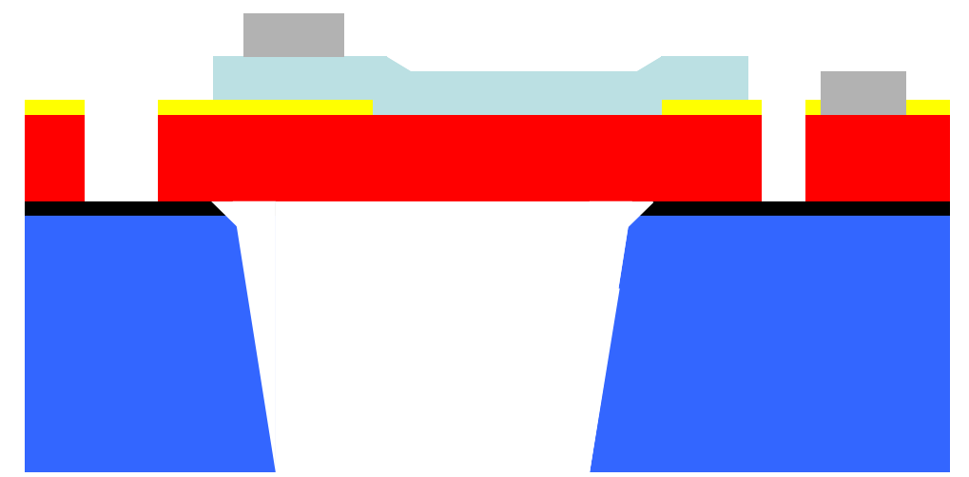
Sensor Modelling – Structure & Methodology
5-mask level SOI patterning technology
Instead of pure AlN layer, the specialized AlN layer doped with Silicon is used, which would introduce extra thermal stress to the bridge resonator.
Section 2: Sensor Modelling
5
PowerMEMS, December 11-14, 2023, Abu Dhabi, UAE
Notes:
The MEMS sensor is fabricated with 5-mask level SOI patterning technology. The key point is that we employ the specialized AlN layer doped with Silicon. Such design would introduce an extra thermal stress to the bridge resonator during the piezoelectric actuation, which would be a superb supplement to the thermal stress applied by external DC electrothermal voltages for resonance frequency tuning.

Slide 7
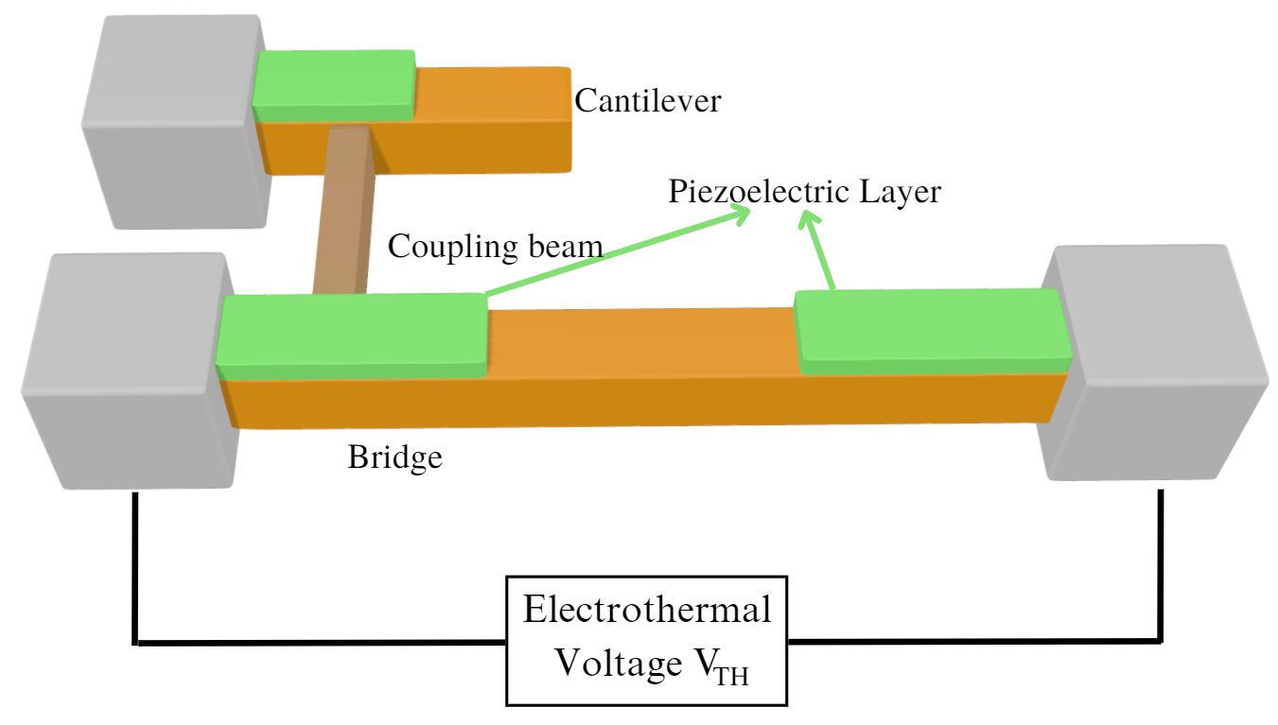
Sensor Modelling – Structure & Methodology
2nd Global Mode —— Side View
1st Global Mode —— Side View
1st Global Mode —— Top View
2nd Global Mode —— Top View
Thermal Conductivity Sensing
The convective cooling from the ambient gas (He/H₂) leads to the thermal expansion, which introduces the stiffness perturbation to bridge resonator.
Section 2: Sensor Modelling
6
PowerMEMS, December 11-14, 2023, Abu Dhabi, UAE
Notes:
This in the main structure of my sensor. This gas sensor comprises a cantilever and a bridge resonator represents as orange bars. A thin coupling beam, which is brown bar, weakly couples both resonators. The external AC actuation will be provided on the AlN piezoelectric layer and lead to the periodic deformation, therefore generate the vibration of whole system. An electrothermal voltage Vth is provided to heat the bridge resonator and tune the resonance frequency. The thermal conductivity sensing technique is used here, which means that if the heated bridge contacts the high thermal conductivity gas like Helium, the bridge will be cooled down due to convection and the stiffness will be changed and influence the resonance frequency. The above graph shows the first two global modeshapes discussed in the experiment. You could find that the vibration of 1st mode is mostly confined on cantilever while the 2nd mode is confined on bridge resonator. Our sensor fabrication used a simple 5-mask level SOI patterning technique, and the cross-section figure is shown in right above.

Slide 8
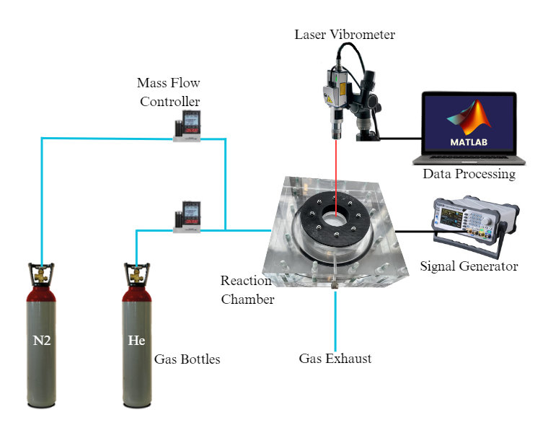
Experiment – Setup
Section 3: Experiments
7
PowerMEMS, December 11-14, 2023, Abu Dhabi, UAE
Notes:
Here are our experiment setup. The MEMS device is placed in the reaction chamber, which is equipped with ports connected to the signal generator, at atmospheric pressure and room temperature. Two gas bottles, which contain Nitrogen and Helium, respectively, provide the gas input in the experiment. Here the Nitrogen is the carrier gas while Helium is the target gas in this experiment. The mass flow controllers which directly connected to the gas bottles are used to control the flow values of the two gases hence adjusting the gas concentration in the chamber. A laser vibrometer is adopted to monitor the motion of the sensor and we used Matlab to process the raw data from vibrometer. The right figure shows the top view of the gas sensor under Scanning Electron Microscope.

Slide 9
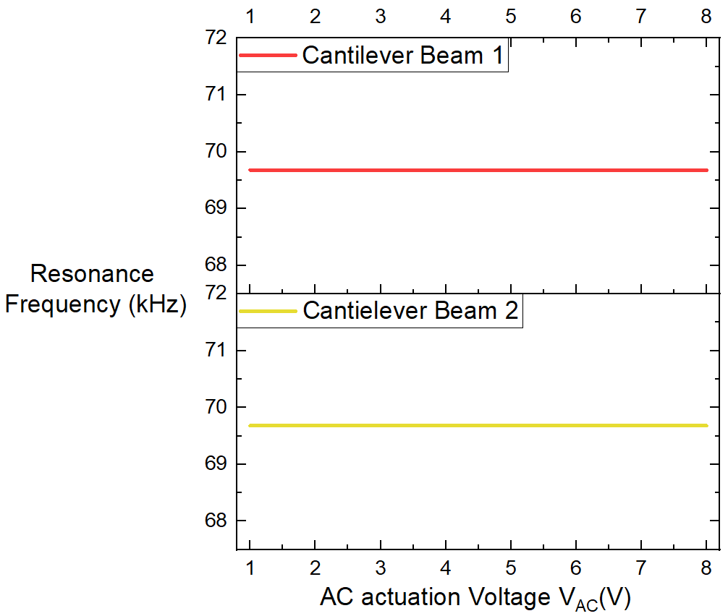
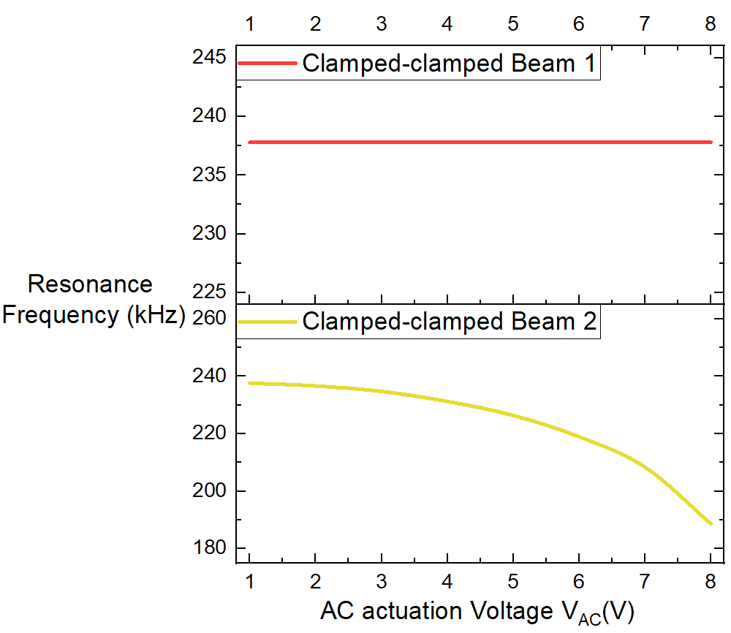
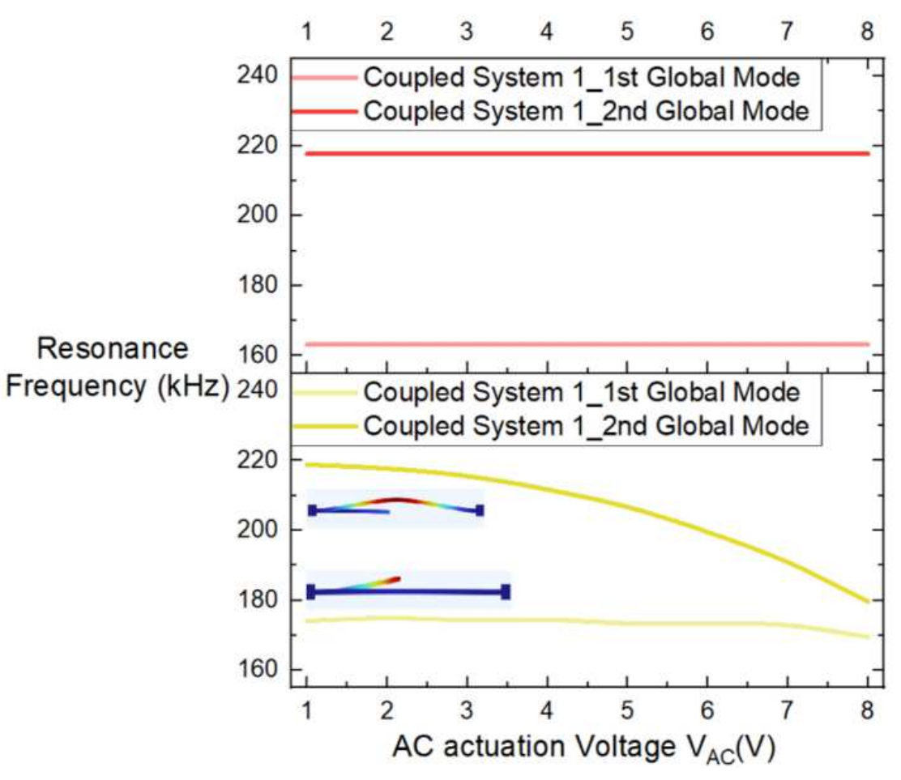
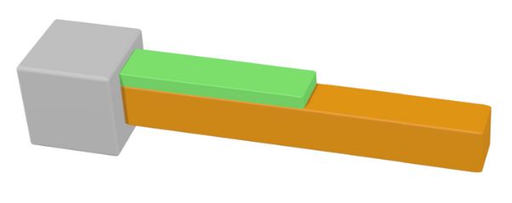
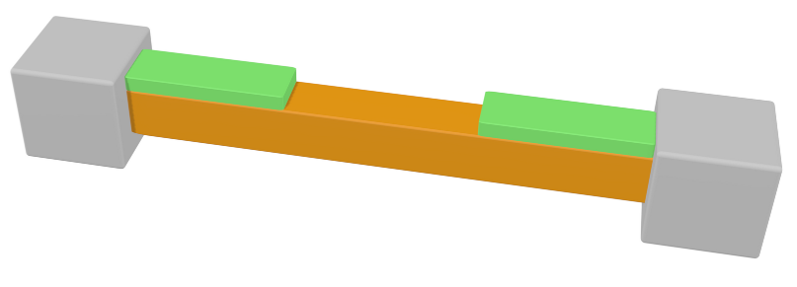
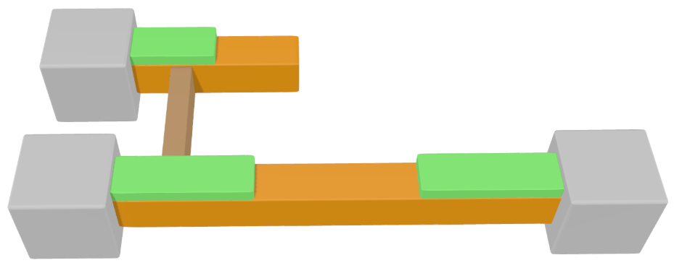
Experiment – Tunable TPoS Resonator Test
Section 3: Experiments
8
PowerMEMS, December 11-14, 2023, Abu Dhabi, UAE
Notes:
Here are the experiment result for the tunable TPoS resonators. We choose three types of TPoS devices, the single cantilever, single bridge, and the coupled structure. For each type of device, we tested two samples, one with pure AlN layer and another one with doped AlN layer, and compared their system dynamics. The results shows that for the TPoS cantilever, our design won’t influence the resonance frequency since the axial stress doesn’t exist in cantilever. However, we could observe frequency shift with increasing Vac for both single bridge and coupled structure, which proves the feasibility of frequency tunning.

Slide 10
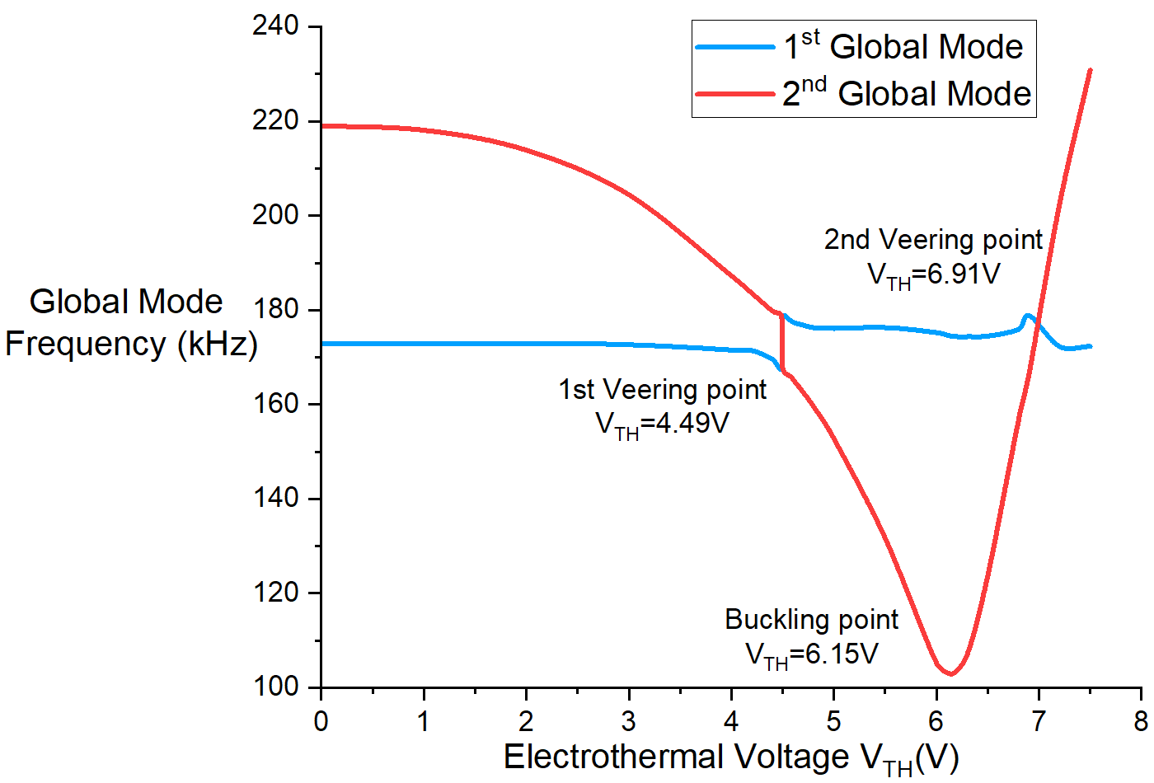
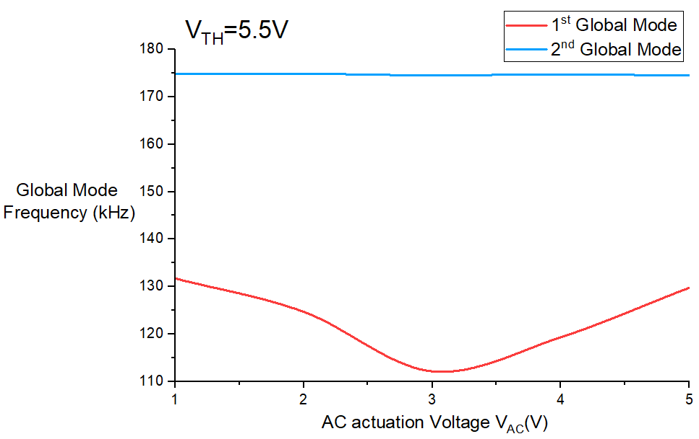
Experiment – Power Consumption
V_{AC}=1V
V_{TH}=5.5V
V_{AC}=1V. Buckling point is at V_{TH}=6.15V
Power consumption: 6.15²/340=111.24mW
V_{AC}=3V. Buckling point is at V_{TH}= 5.5V
Power consumption: 5.5²/340=88.97mW
Improved by 27.21%
Section 3: Experiments
9
PowerMEMS, December 11-14, 2023, Abu Dhabi, UAE
Notes:
The system dynamics of coupled structure is further analyzed. The left graph shows the resonance frequency variation via the electrothermal voltage at VAC=1V. It should be noted that the buckling point is 6.15V. In the right graph, I set electrothermal voltage at 5.5V and sweep the AC actuation voltages, which shows that when VAC=3V, the system is buckled. It could be simply found that two graphs have similar variation tendency, which proves that our design provide thermal stress in the same way as the DC electrothermal heating function. Since the resistance between AlN layer and silicon beam is extensively larger than the silicon beam itself, one for several mega Ohm and one for 310 Ohm. The power consumption is improved by 20.02%, which is a quite remarkable improvement.

Slide 11
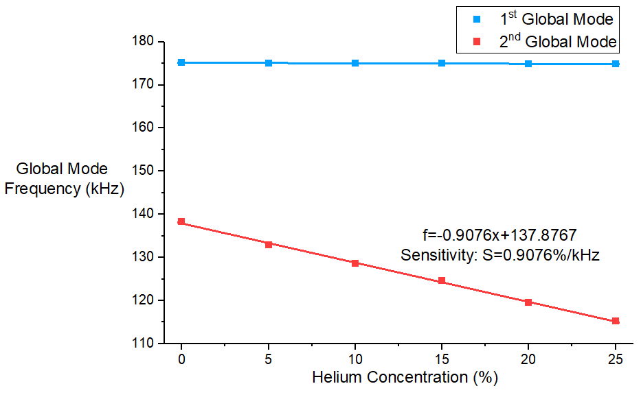
Experiment – Helium Experiment Result
1st Global Mode: Keeps same
2nd Global Mode: Vary
$V_{AC}=1V V_{TH}=6.6V$.
Sensitivity: 0.9076%/kHz.
Section 3: Experiments
10
PowerMEMS, December 11-14, 2023, Abu Dhabi, UAE
Notes:
Here are the experiment result for our sensor. In the experiment, we inset the increasing concentration of Helium gases which will cool down the bridge resonator, hence counteract the influence of electrothermal heating. From the experiment result, we can find that the 1st mode’s resonance frequency keeps same while the 2nd mode’s resonance frequency is influenced. The results shows the Helium sensing at VTH=6.6V gives high linear results with sensitivity of 0.9076%/kHz, shows its great potential.

Slide 12
Conclusions
□ A novel tunable TPoS MEMS gas sensor which could reduce the power consumption during the resonance frequency tunning process is proposed. Which has great potential on low-power consumption sensing, programmable switch, IOT applications.
□ The resonance frequency tunning theory is proved experimentally.
□ The Helium sensing experiment shows highly linear and sensitivity results.
□ The future work will focus on the theoretically discussion of the resonance frequency tunning theory and the multi-gas sensing on single coupled structure through introducing another sensing technique (i.e. coating technique) on cantilever.
Section 4: Conclusions
11
PowerMEMS, December 11-14, 2023, Abu Dhabi, UAE
Notes:
Now I would like to conclude our research. Firstly, we proposed a novel tunable TPoS MEMS gas sensor which could reduce the power consumption during the resonance frequency tunning process. The experiment result proves the tunning theory. Then, the Helium sensing experiment shows highly linear and sensitivity results. In the future, we will focus on the theoretically analysis of resonance frequency tunning theory. Also, the multi-gas sensing on single coupled structure through introducing another sensing technique (i.e. coating technique) on cantilever is another research direction.

Slide 13
References
Gong, X., Kuo, Y.-C., Zhou, G., Wu, W.-J., & Liao, W.-H. (2023). An aerosol deposition based MEMS piezoelectric accelerometer for low noise measurement. Microsystems & Nanoengineering, 9(1), 23. https://doi.org/10.1038/s41378-023-00484-5
Alcheikh, N., Ben. Mbarek, S., Ouakad, H. M., & Younis, M. I. (2021). A highly sensitive and wide-range resonant magnetic micro-sensor based on a buckled micro-beam. Sensors and Actuators A: Physical, 328, 112768. https://doi.org/10.1016/j.sna.2021.112768
el Mansouri, B., Middelburg, L. M., Poelma, R. H., Zhang, G. Q., van Zeijl, H. W., Wei, J., Jiang, H., Vogel, J. G., & van Driel, W. D. (2019). High-resolution MEMS inertial sensor combining large-displacement buckling behaviour with integrated capacitive readout. Microsystems & Nanoengineering, 5(1), 60. https://doi.org/10.1038/s41378-019-0105-y
Hajjaj, A. Z., Jaber, N., Alcheikh, N., & Younis, M. I. (2020). A Resonant Gas Sensor Based on Multimode Excitation of a Buckled Microbeam. IEEE Sensors Journal, 20(4), 1778–1785. https://doi.org/10.1109/JSEN.2019.2950495
Fang, Z., Theodossiades, S., Ruzziconi, L., & Hajjaj, A. Z. (2023). A multi-sensing scheme based on nonlinear coupled micromachined resonators. Nonlinear Dynamics, 111(9), 8021–8038. https://doi.org/10.1007/s11071-023-08294-0
References
PowerMEMS, December 11-14, 2023, Abu Dhabi, UAE

Slide 14
Thank You!
z.fang@lboro.ac.uk
Questions and Answers
PowerMEMS, December 11-14, 2023, Abu Dhabi, UAE
Notes:
Veering (avoided-crossing) occurs when two frequencies approach each other as varying a control parameter due to a linear coupling between two modes and then deviate away from each other, and each one continues along the path that the other would have taken if they would cross. Henceforth, both modes get affected, in the veering zone, by the shape of each other, known as mode hybridization.
Here the buckling point represents that with the increase of thermal stress, which provided by electrothermal voltage, when the thermal stress reaches the critical value, the bridge resonator will suddenly change its shape. Take this ruler as example, it is straight without any load, if we add sufficient load, it would bend. The transition of the deformation leads to the switch of physical dynamics.
bridge resonator is dominated by the quadratic nonlinearity linked to curvature and shift to left with increasing Vth
bridge resonator is buckled, and the dominated nonlinearity is the cubic nonlinearity from midplane stretching hence the resonance frequency shift to right

